Slide 1
Quantification of bacterial replication rates (PTRs): A new perspective to study the dynamic role of microbes in IBD? IBIRI LAB MEETING
Ashok Kumar Sharma
Oct 21st, 2022
Casero and Devkota Lab
The Inflammatory Bowel and Immunobiology Research Institute (IBIRI)
Department of Gastroenterology
Cedars Sinai Medical Center

Slide 2

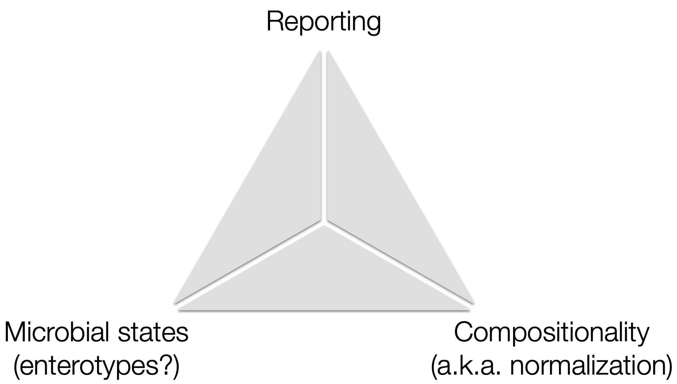
Microbial analysis
Limitations in microbial analysis

Slide 3
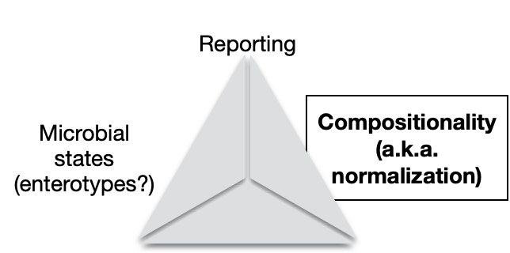

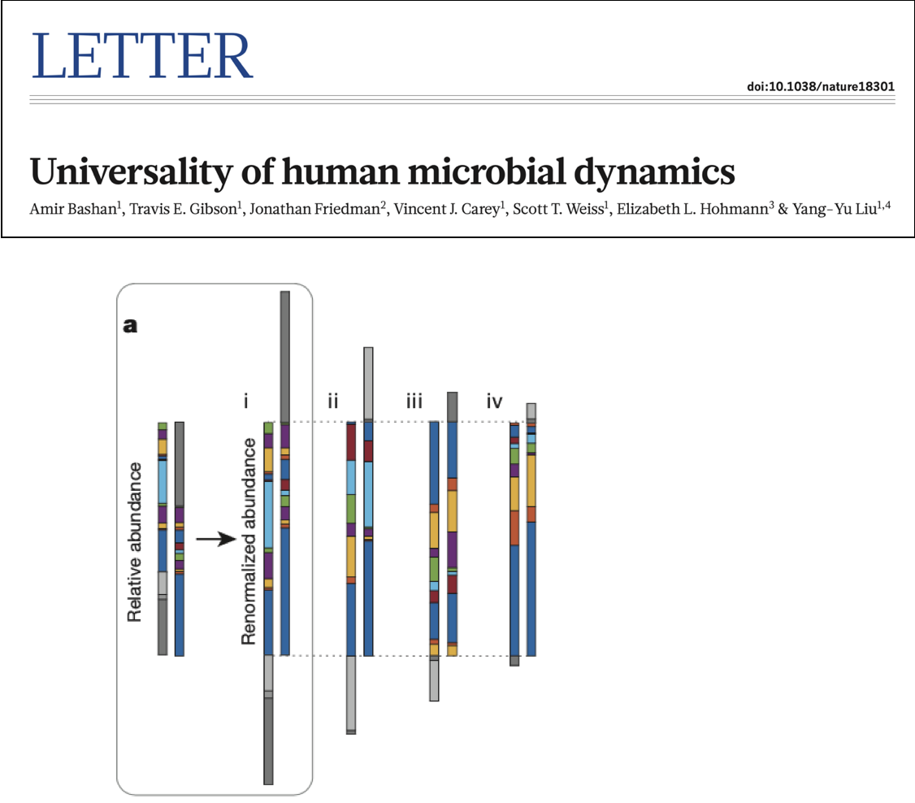
Microbial analysis
Bacterial replication rates

Slide 4
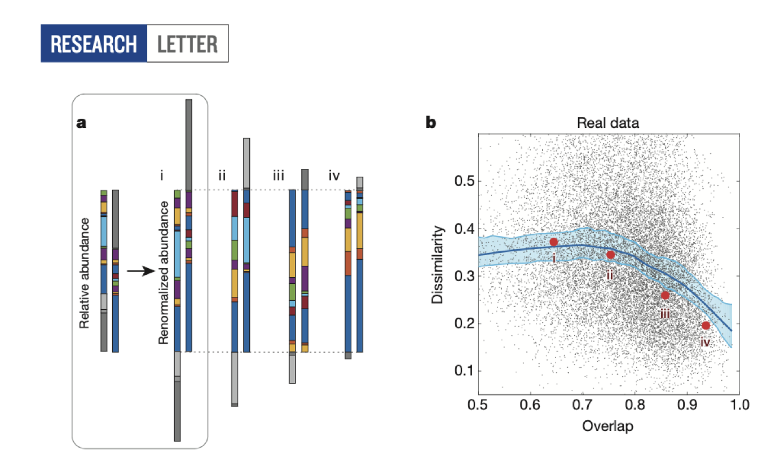
Microbial analysis
Bacterial replication rates

Slide 5
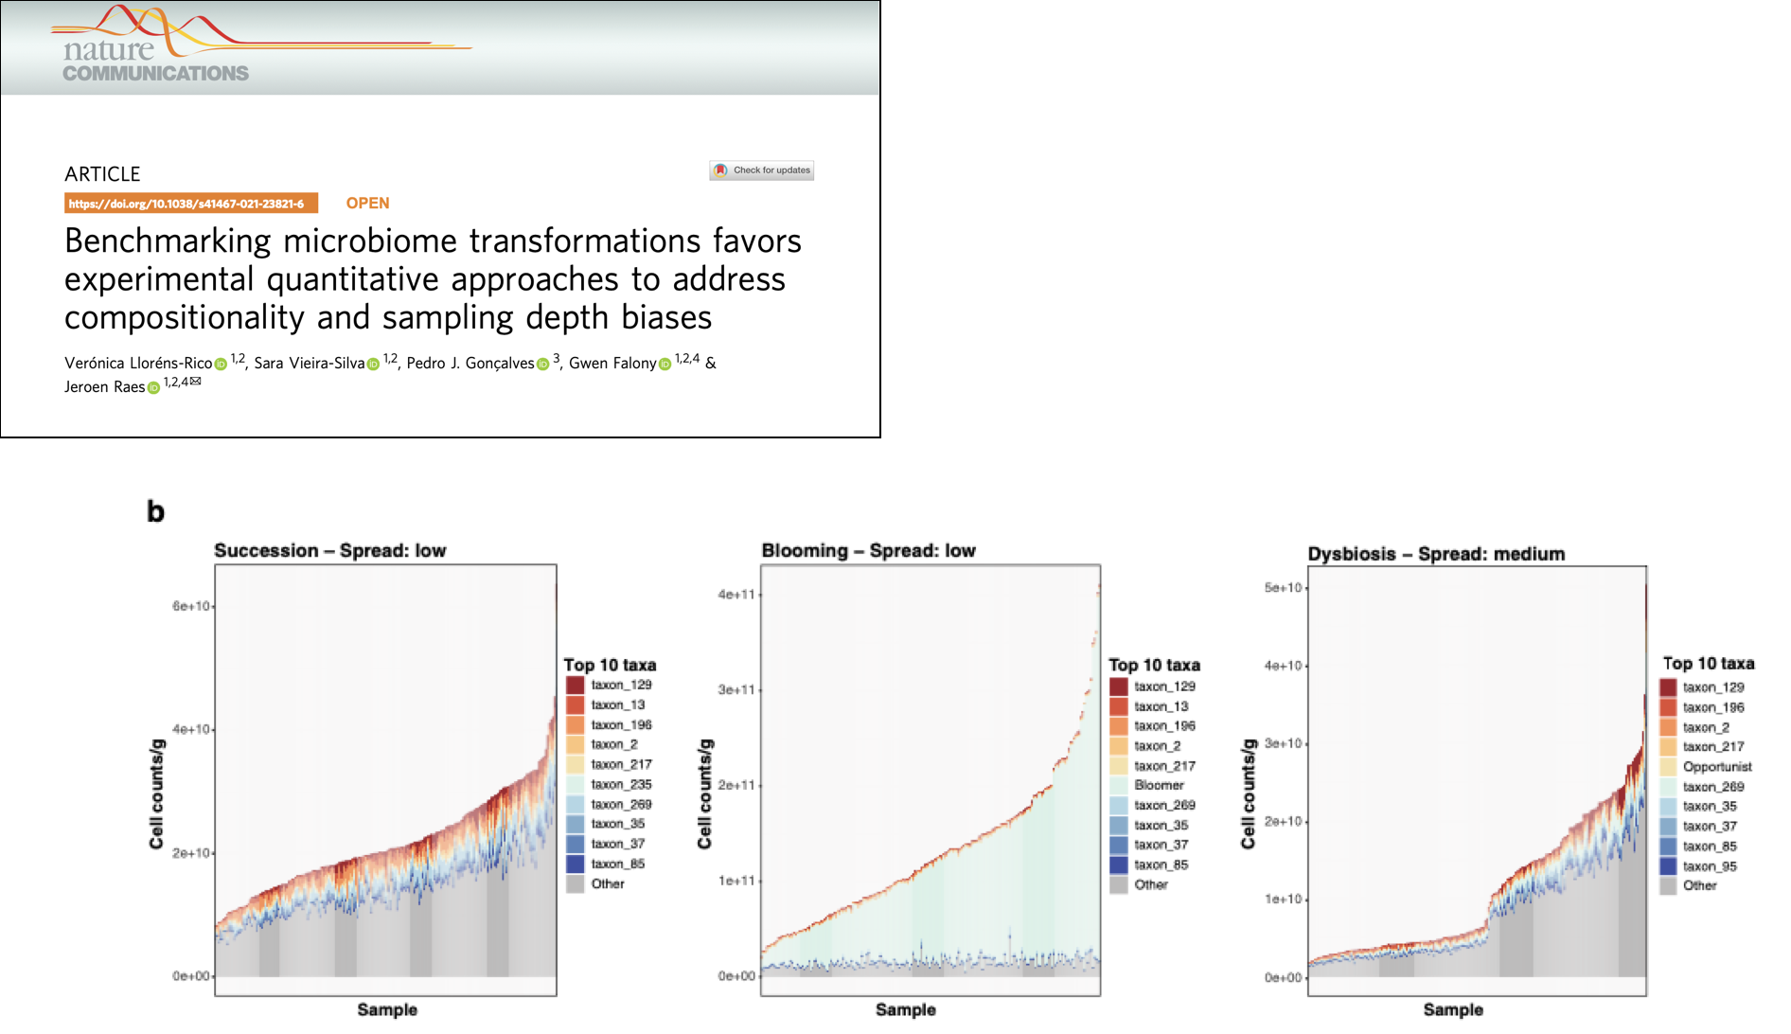
Microbial analysis
Bacterial replication rates

Slide 6
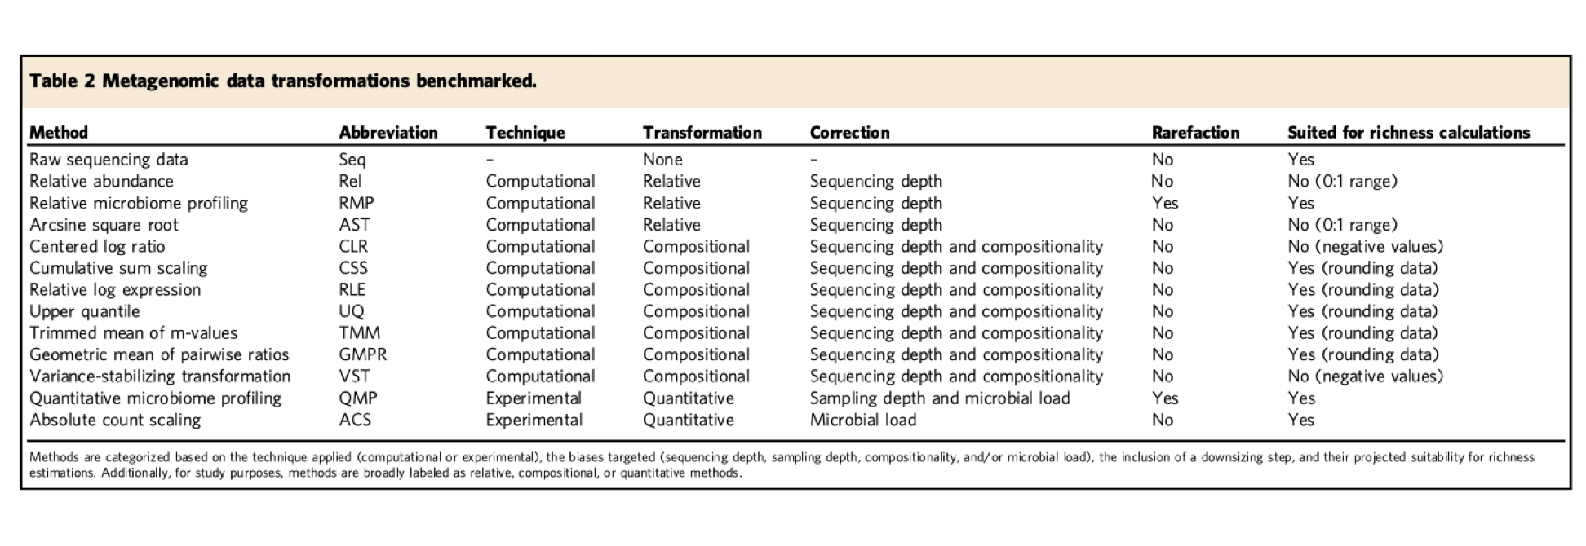
Microbial analysis
Bacterial replication rates

Slide 7

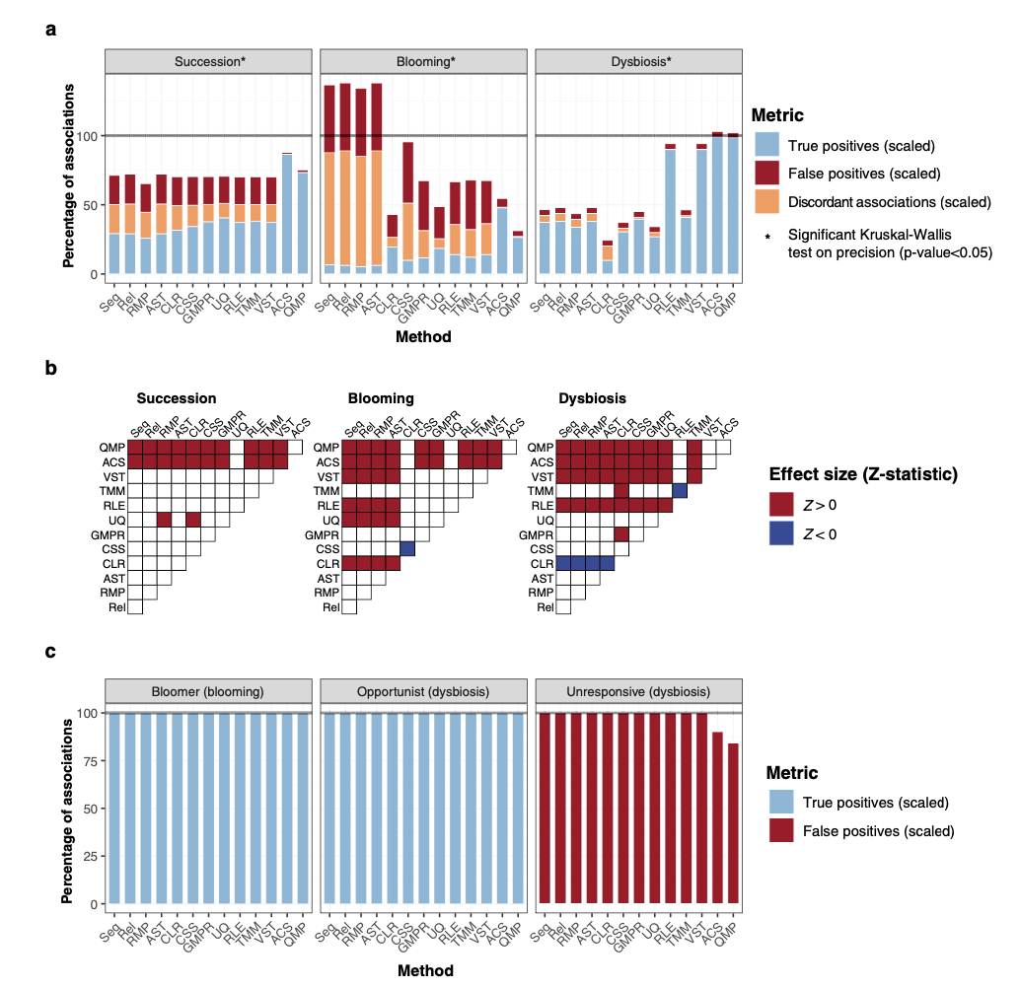
Microbial analysis
Bacterial replication rates

Slide 8
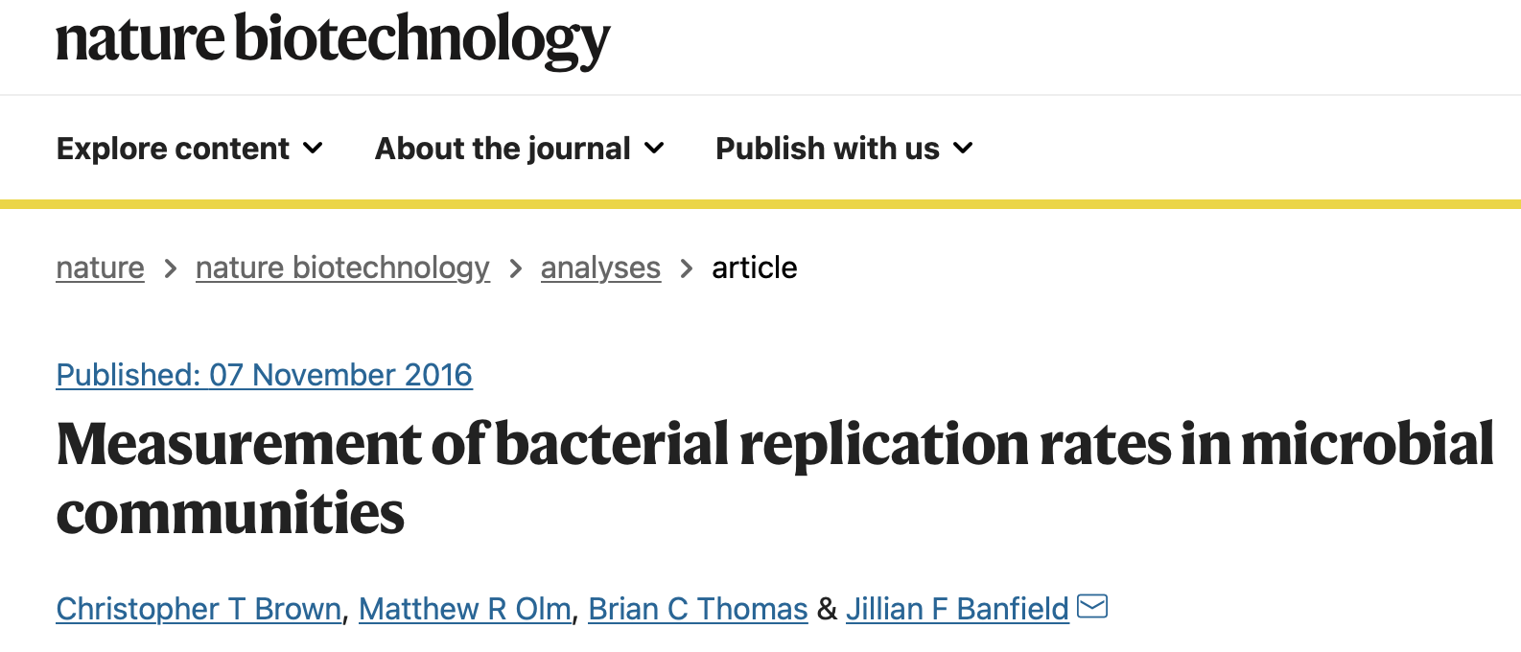
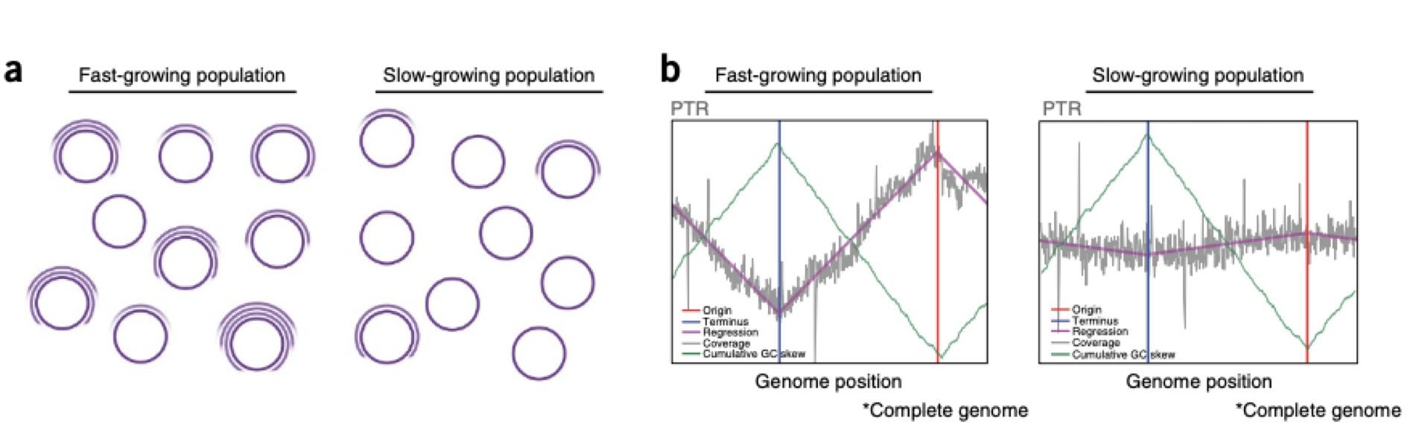
Microbial analysis
Bacterial replication rates

Slide 9
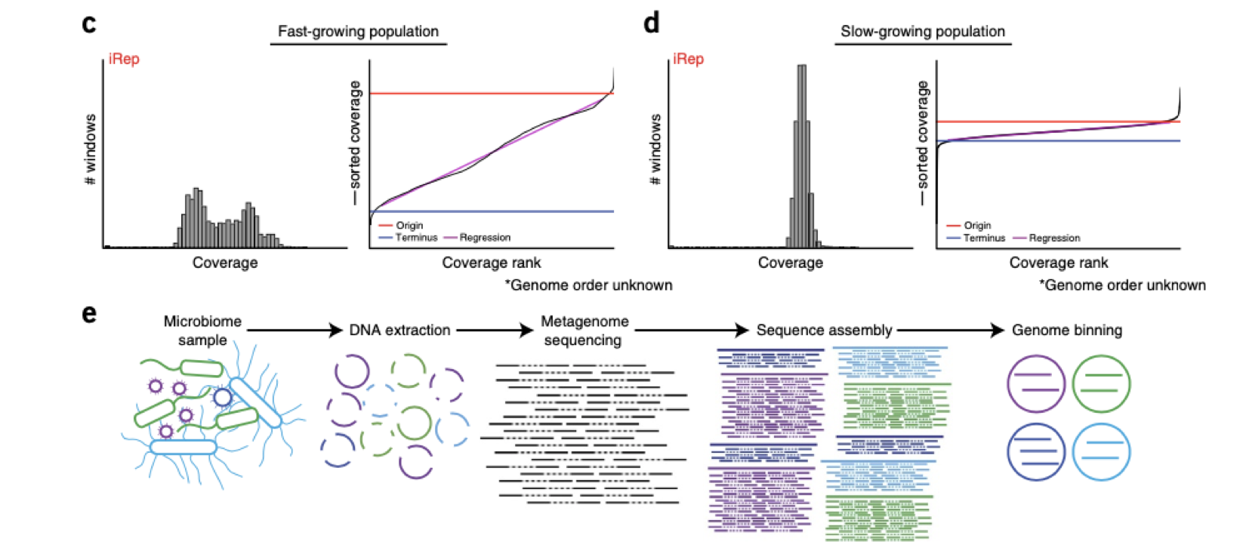
Microbial analysis
Bacterial replication rates

Slide 10

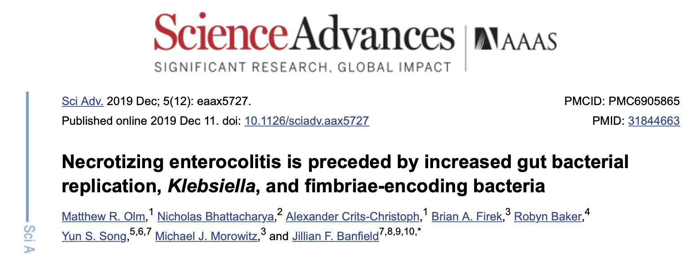
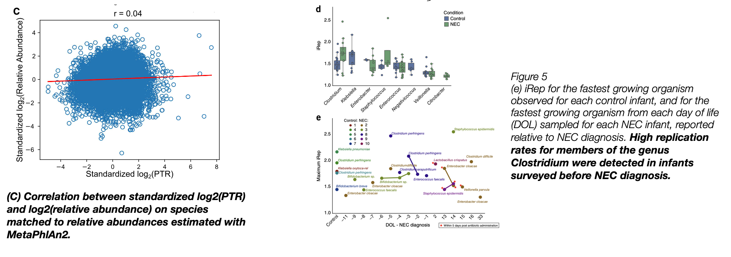
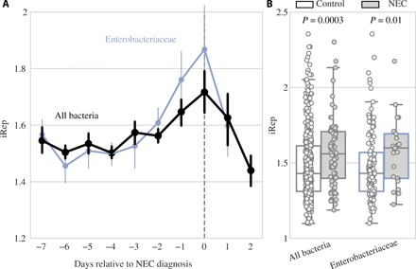
Microbial analysis
Bacterial replication rates

Slide 11
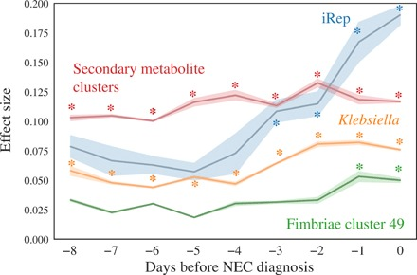
Microbial analysis
Bacterial replication rates

Slide 12
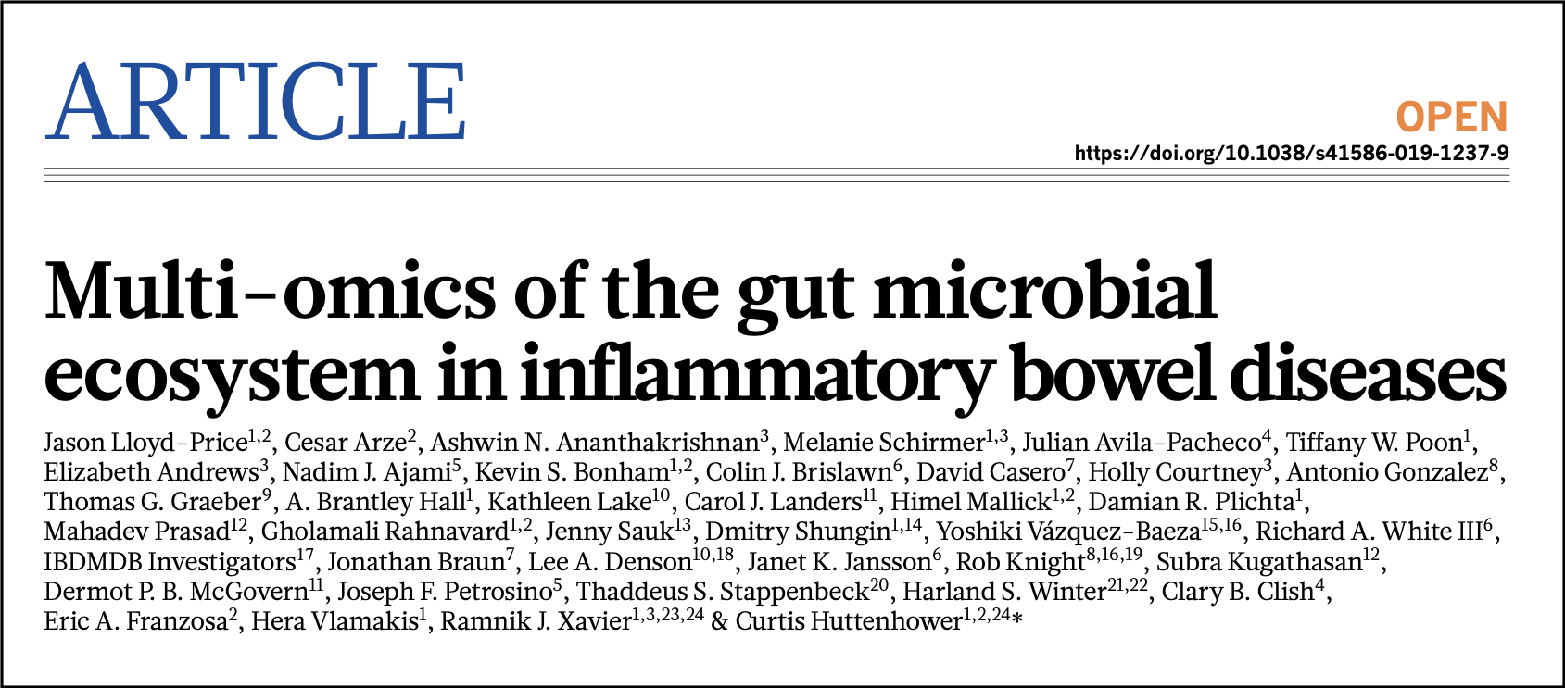
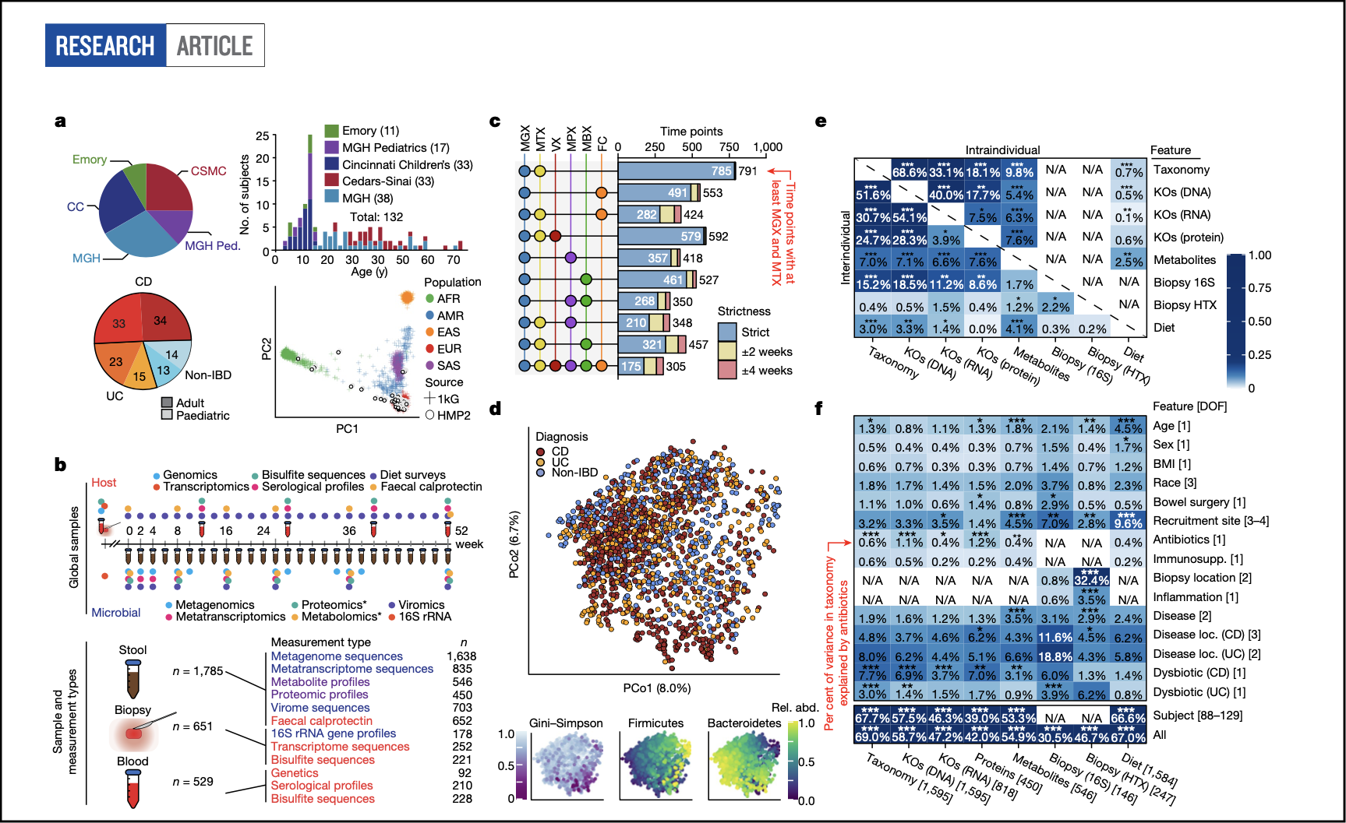
Microbial analysis
Bacterial replication rates

Slide 13
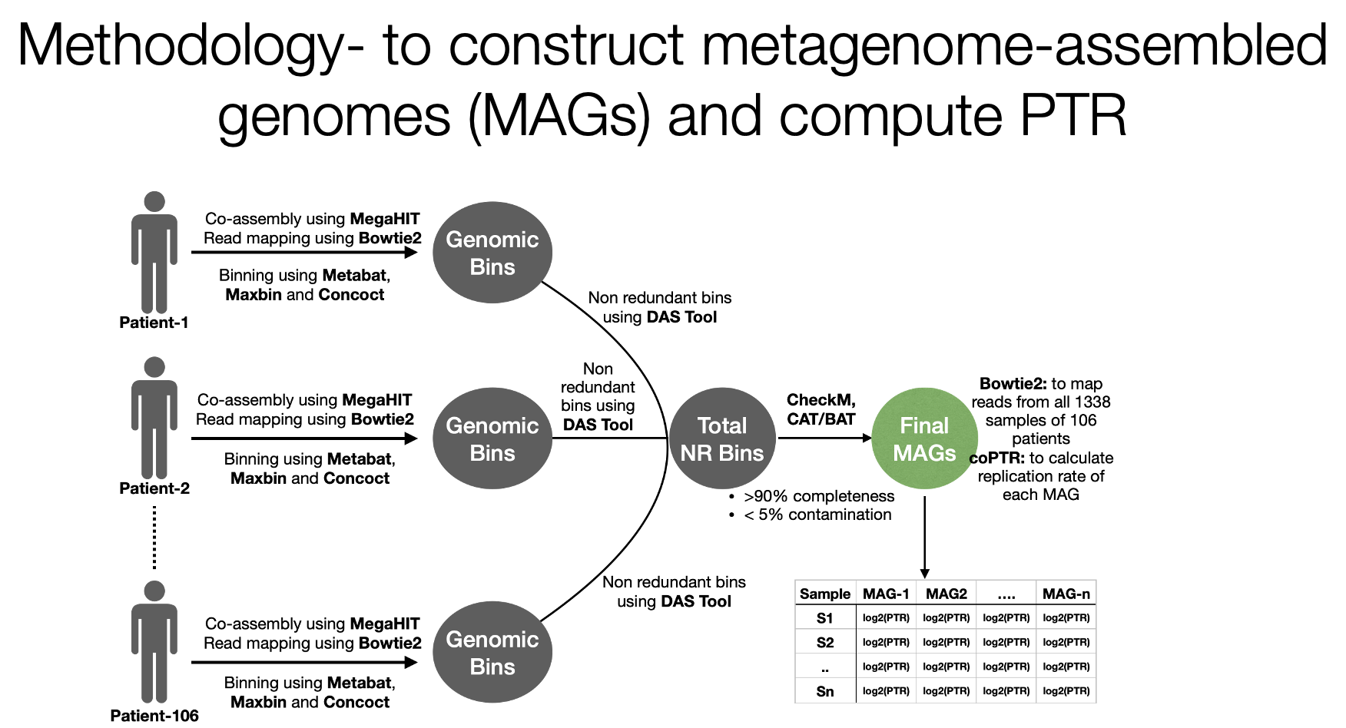
Microbial analysis
Bacterial replication rates

Slide 14
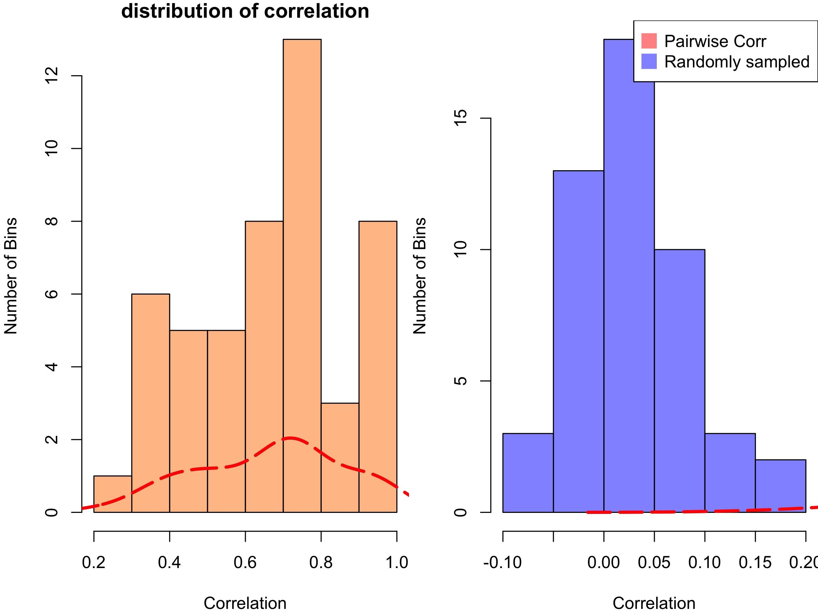
Microbial analysis
Bacterial replication rates
Strong correlation between PTR estimates of each MAG with its representative reference genome (based on 95% ANI)

Slide 15
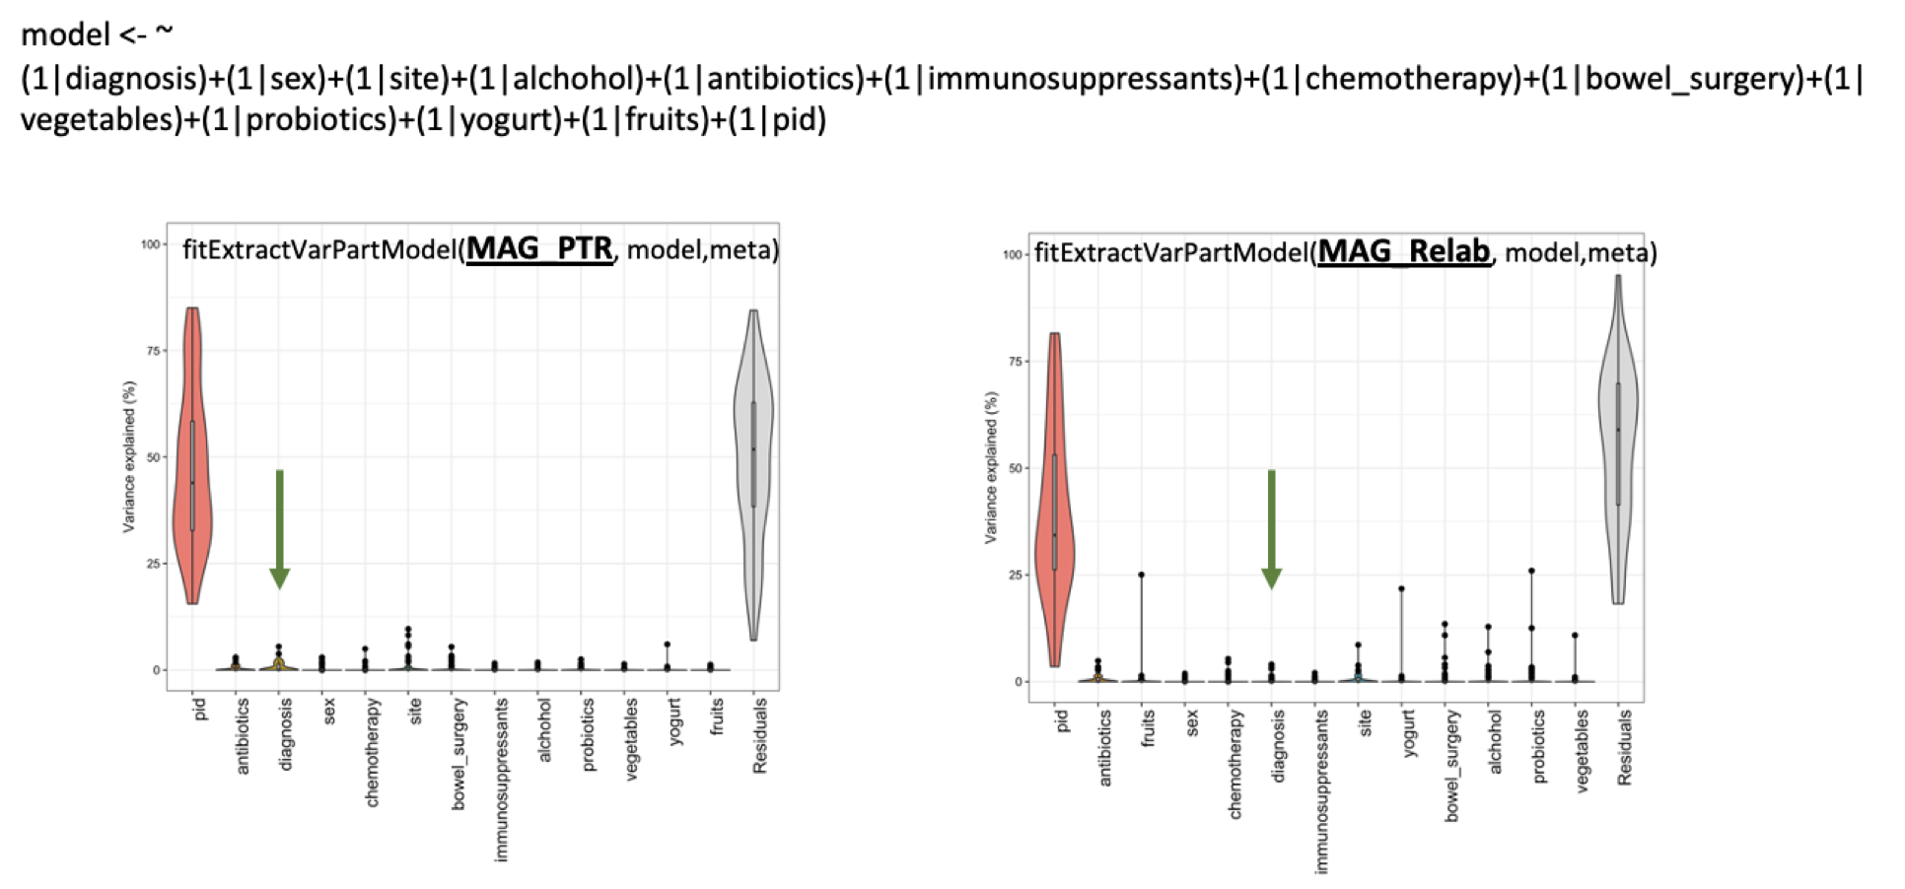
Microbial analysis
Bacterial replication rates
PCoA and Variance partition analysis: Replication rates vs Relative abundances of MAGs

Slide 16
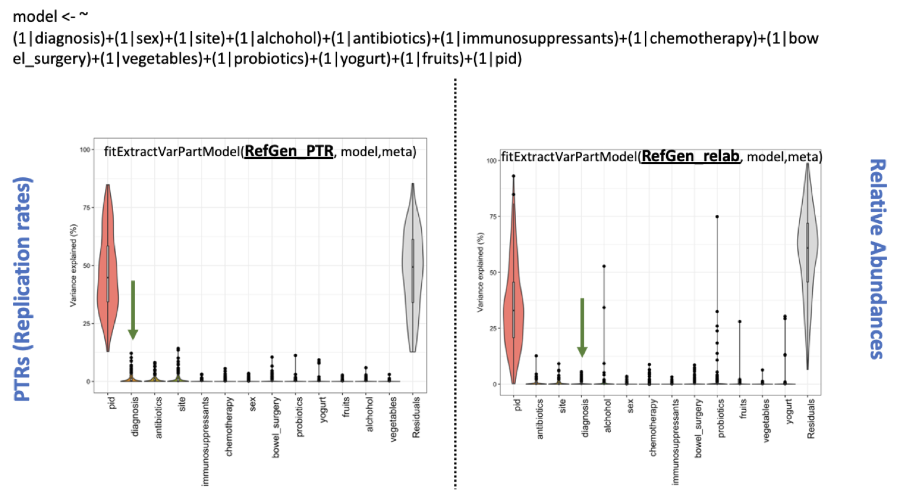
Microbial analysis
Bacterial replication rates
PCoA and Variance partition analysis: Replication rates vs Relative abundances of Reference genomes

Slide 17
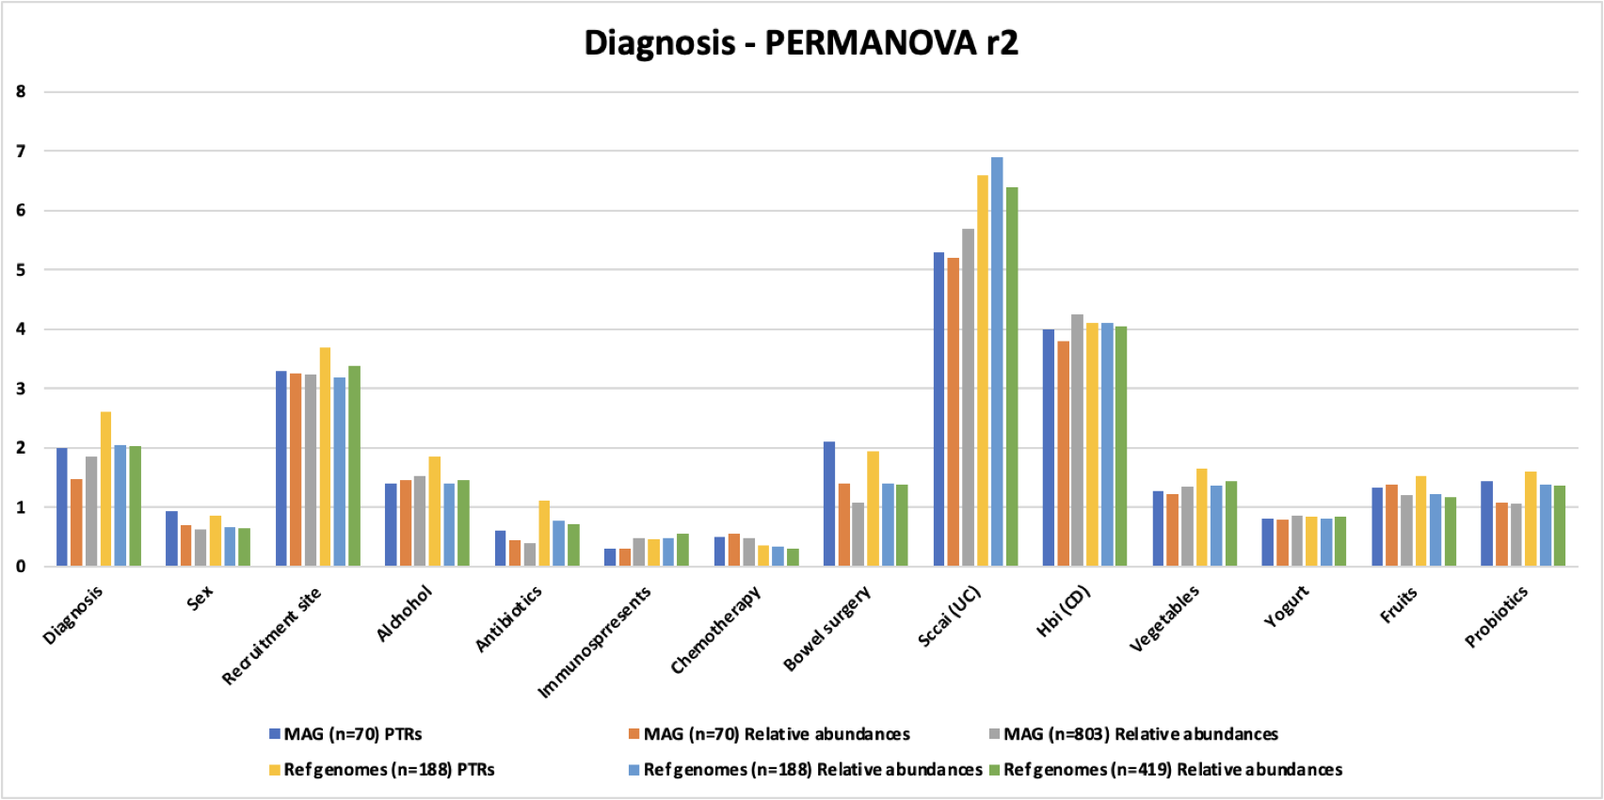
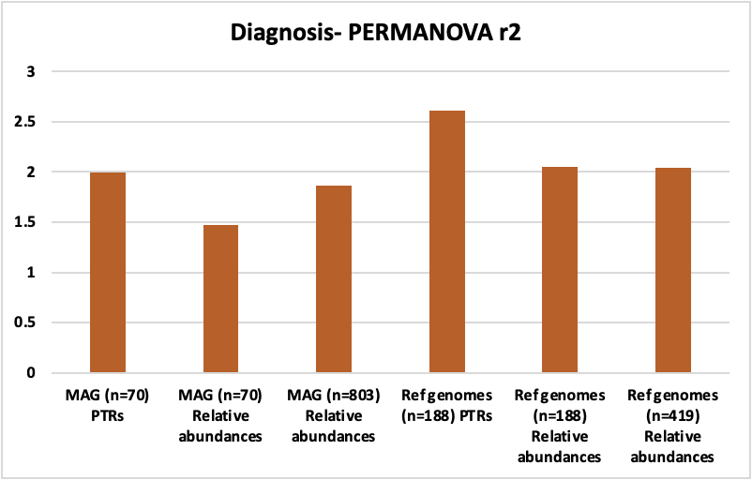
Microbial analysis
Bacterial replication rates
PTR estimates showed better association with clinical phenotypes as compared to relative abundances
Diagnosis – PERMANOVA r2

Slide 18
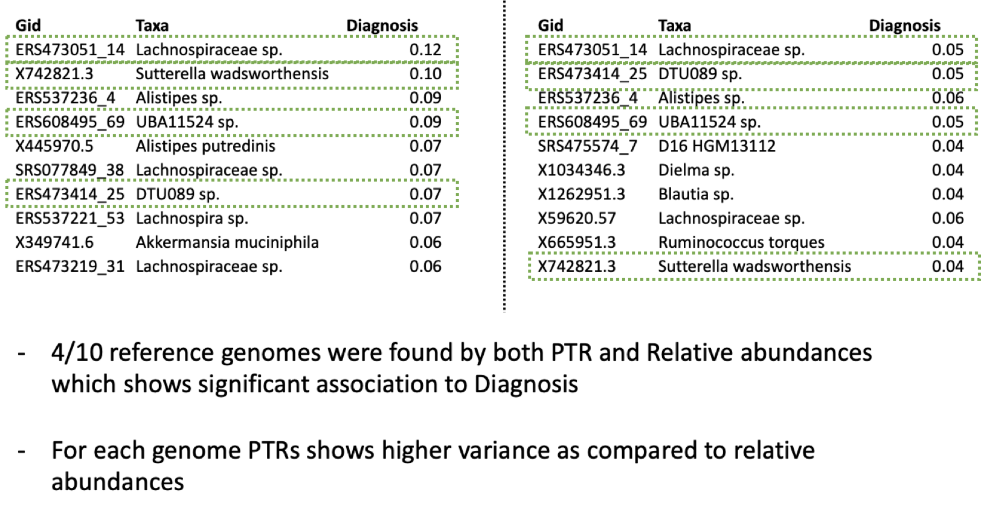
Microbial analysis
Bacterial replication rates
Top ten Reference Genomes associated with disease phenotype
PTRs
Relative abundances

Slide 19
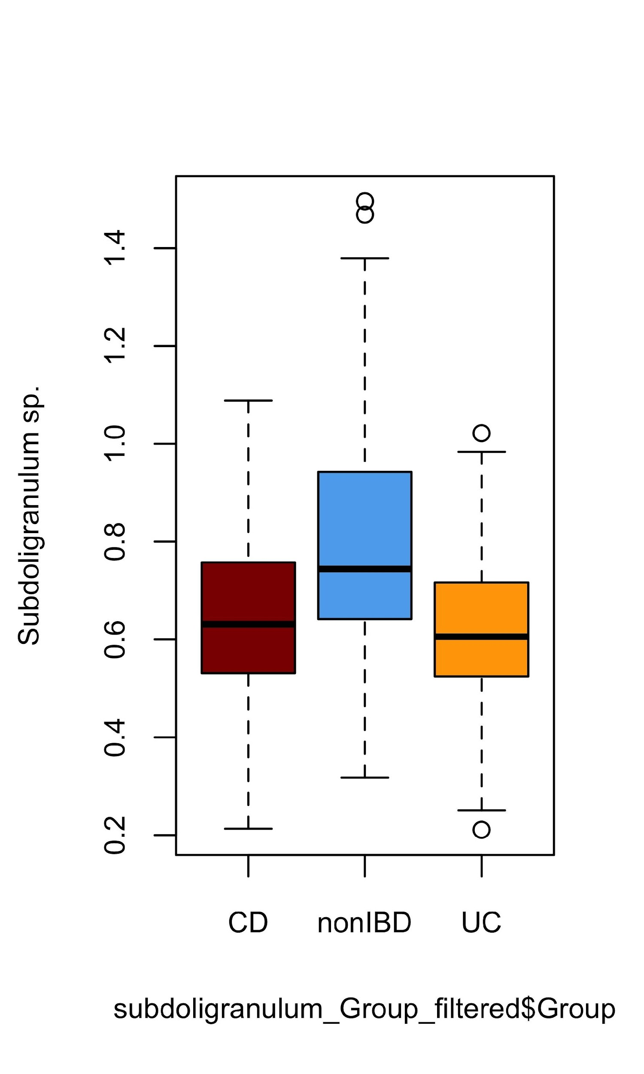
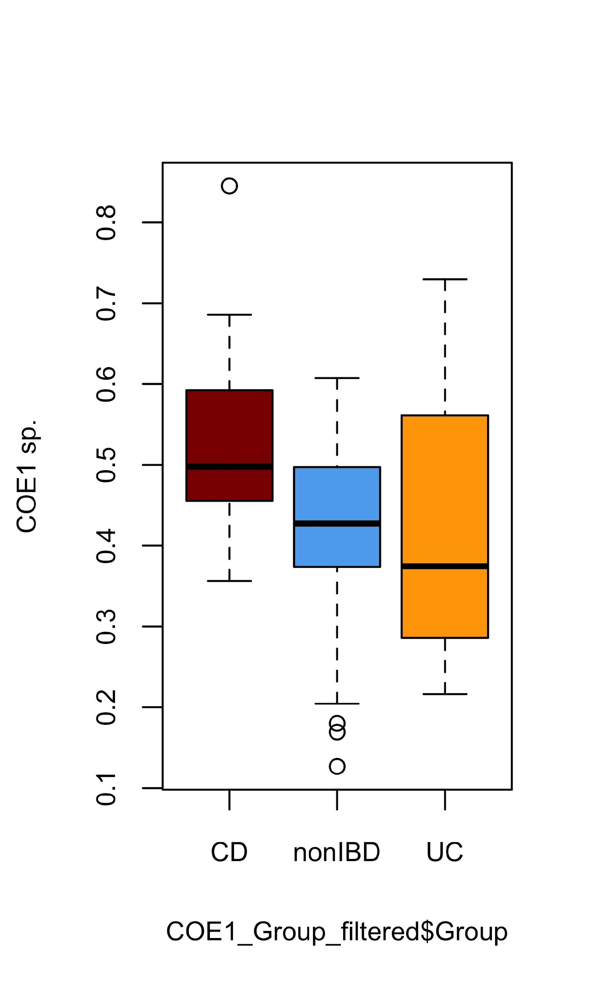
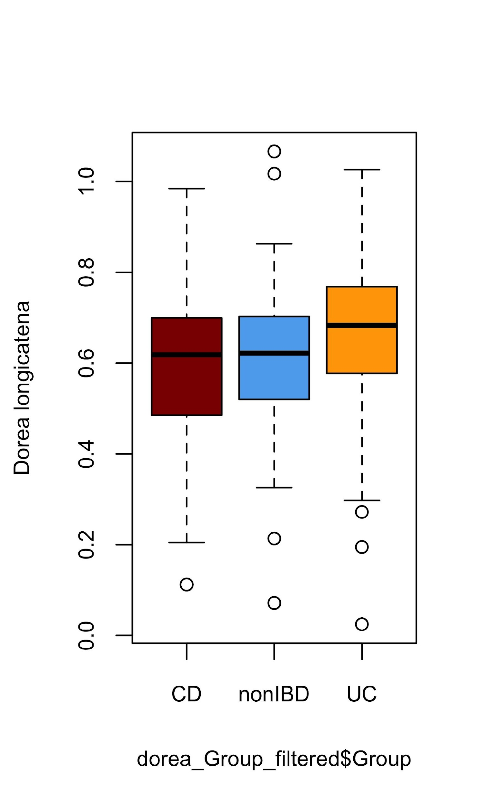
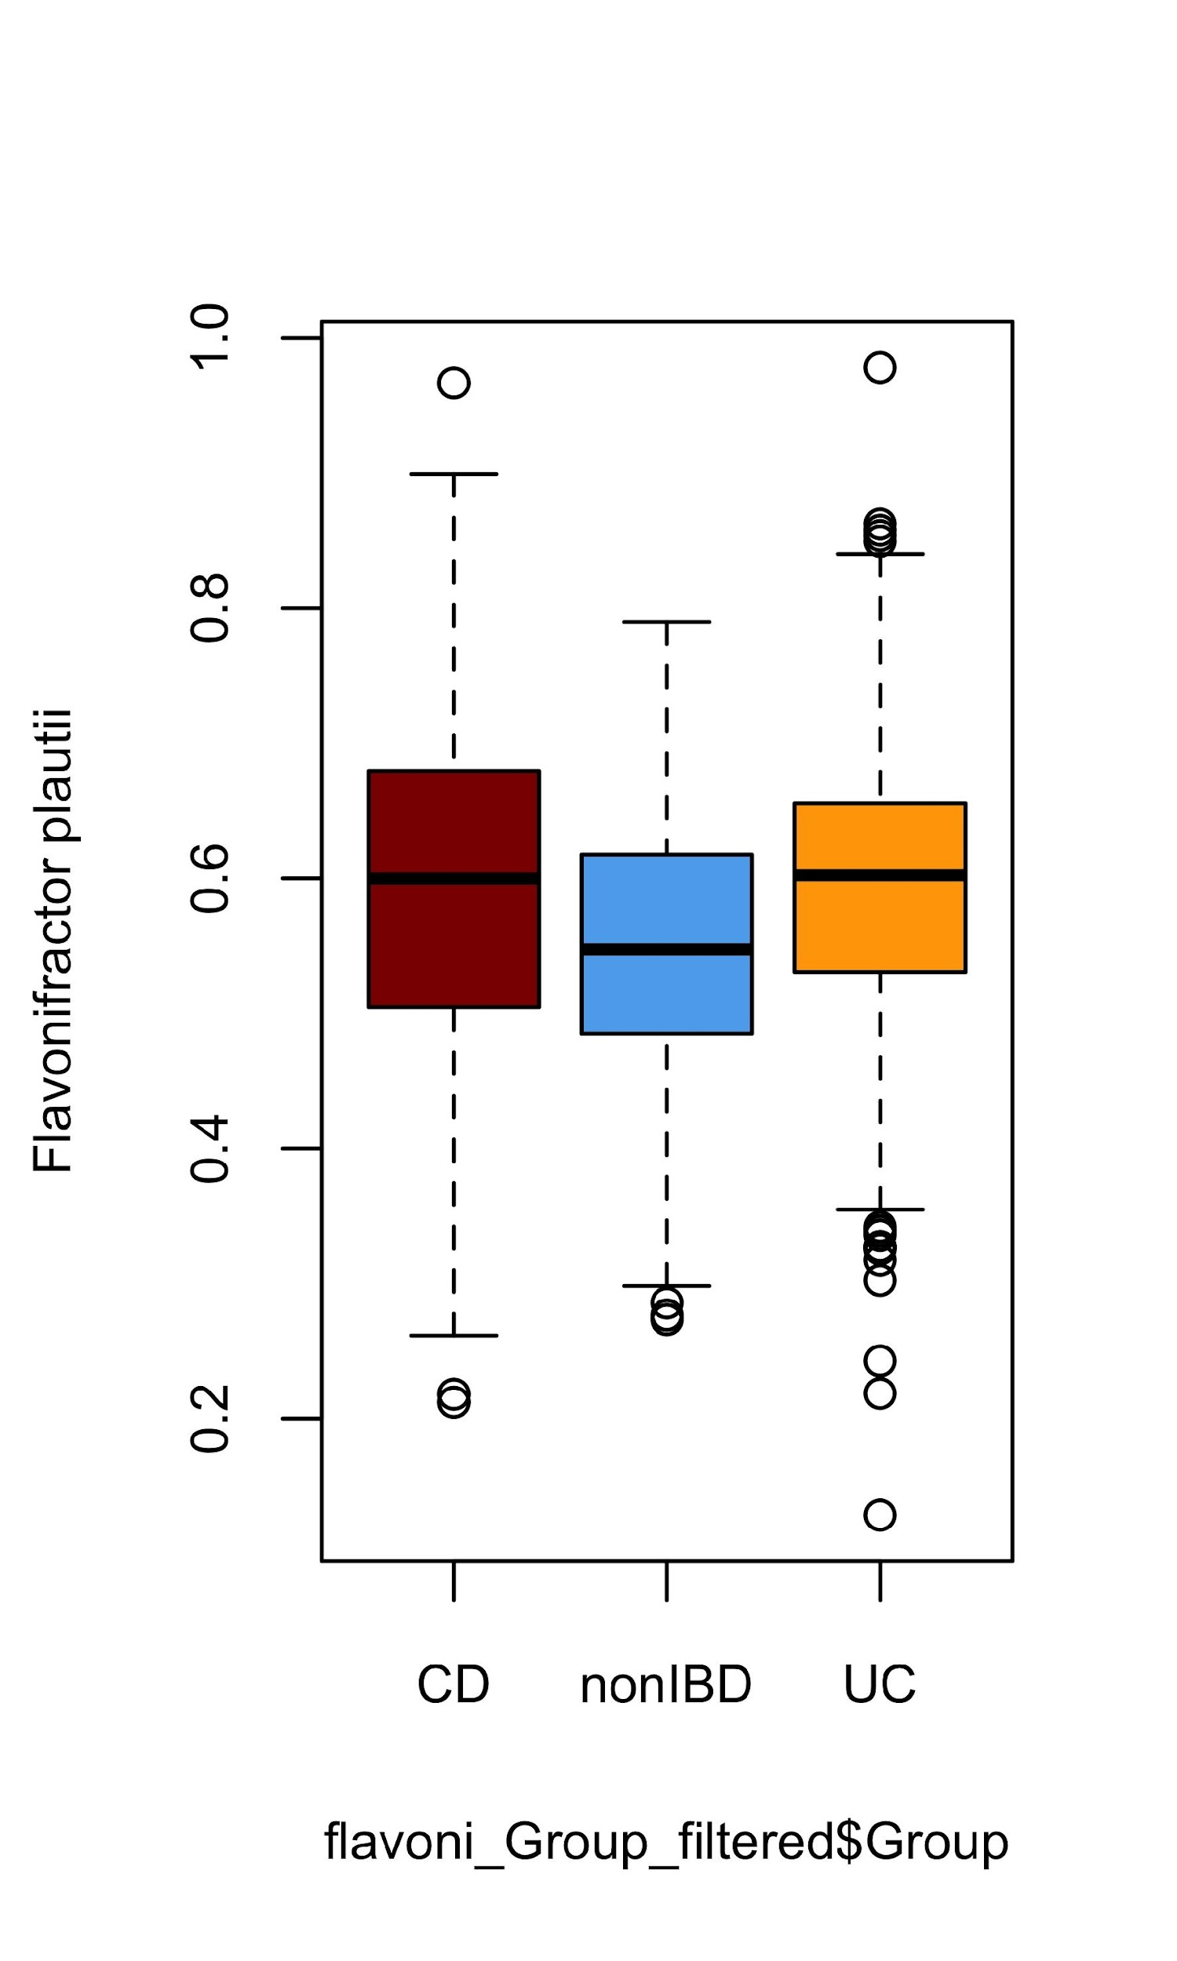
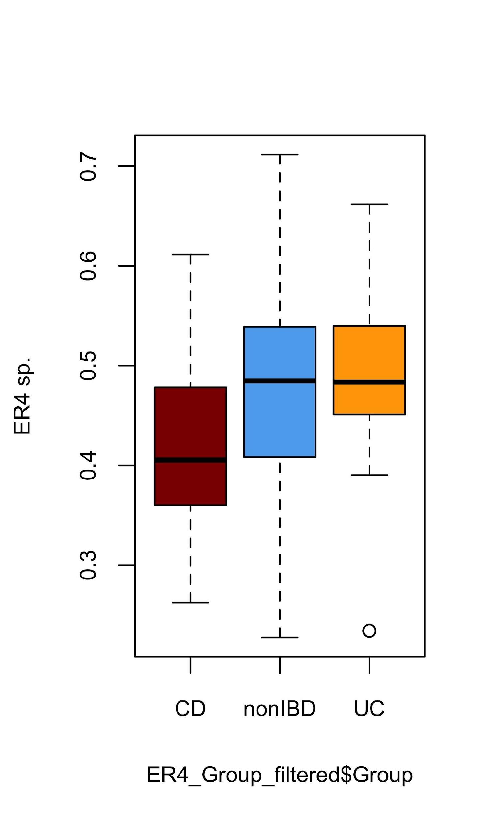
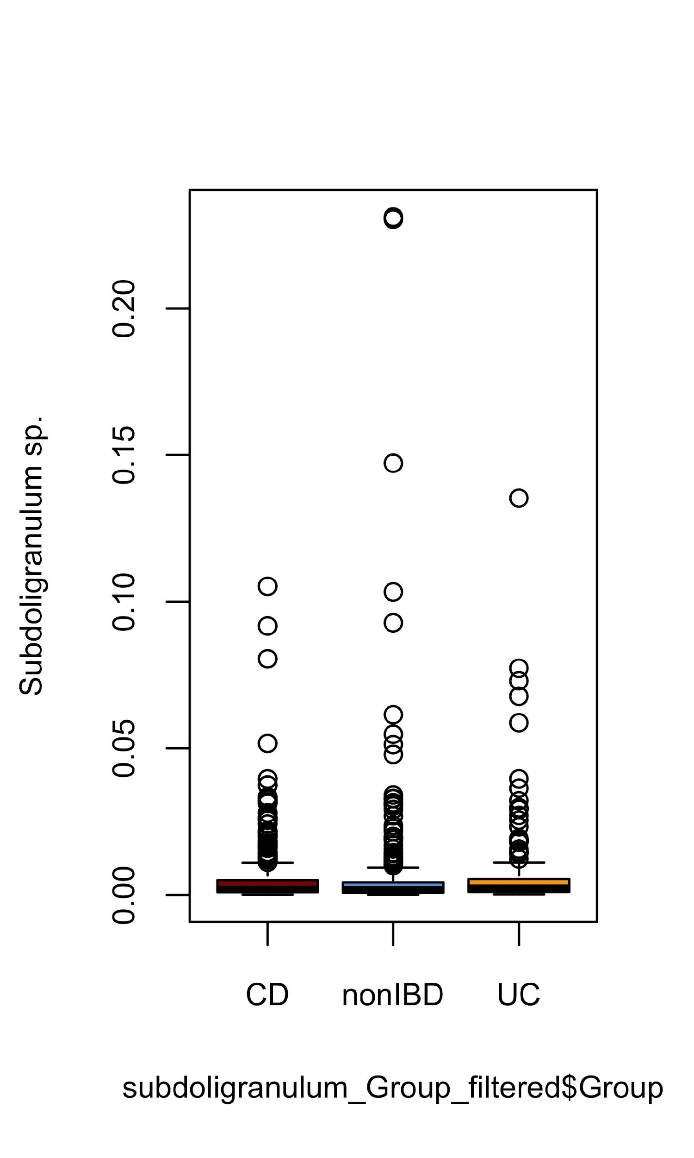
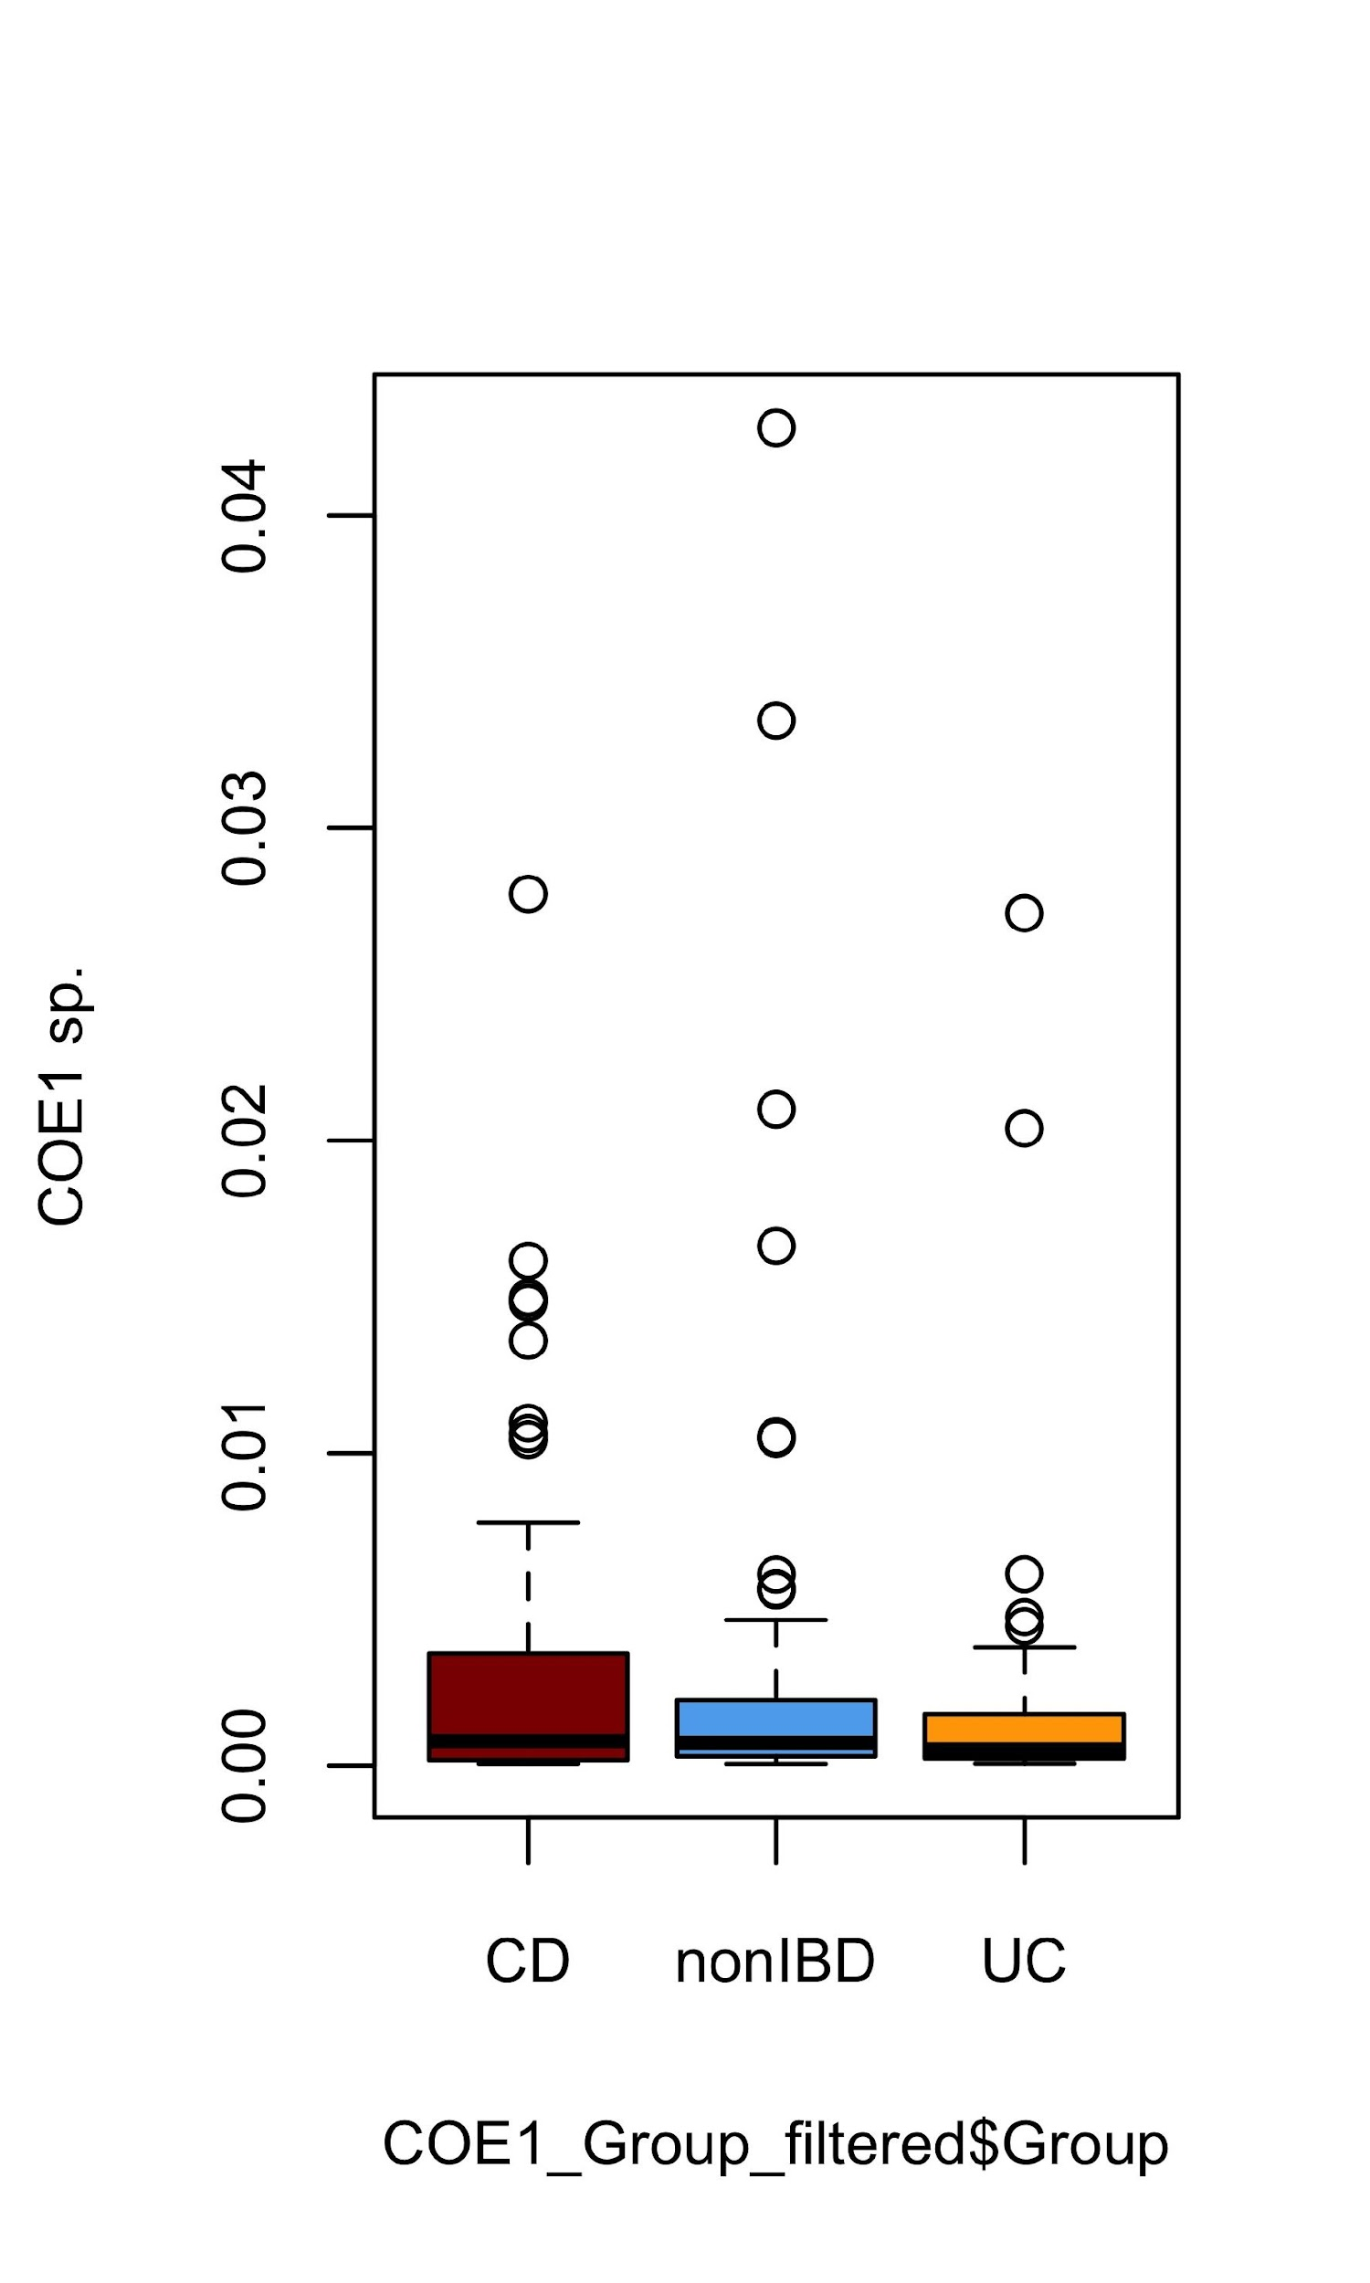
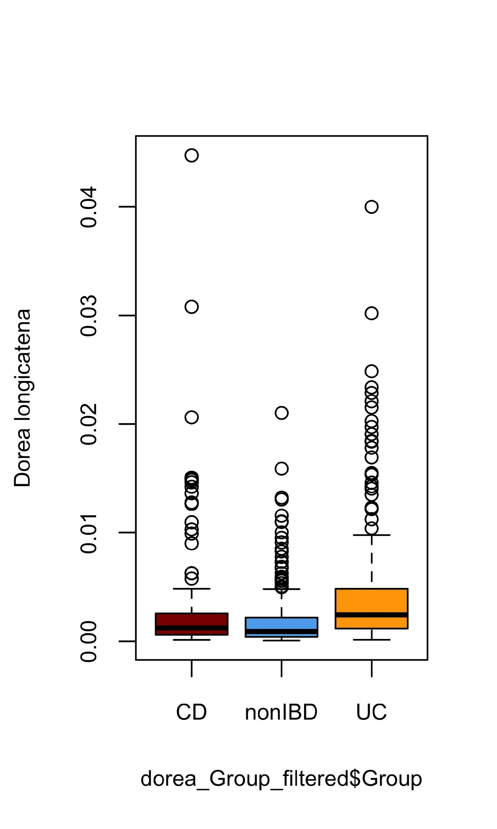
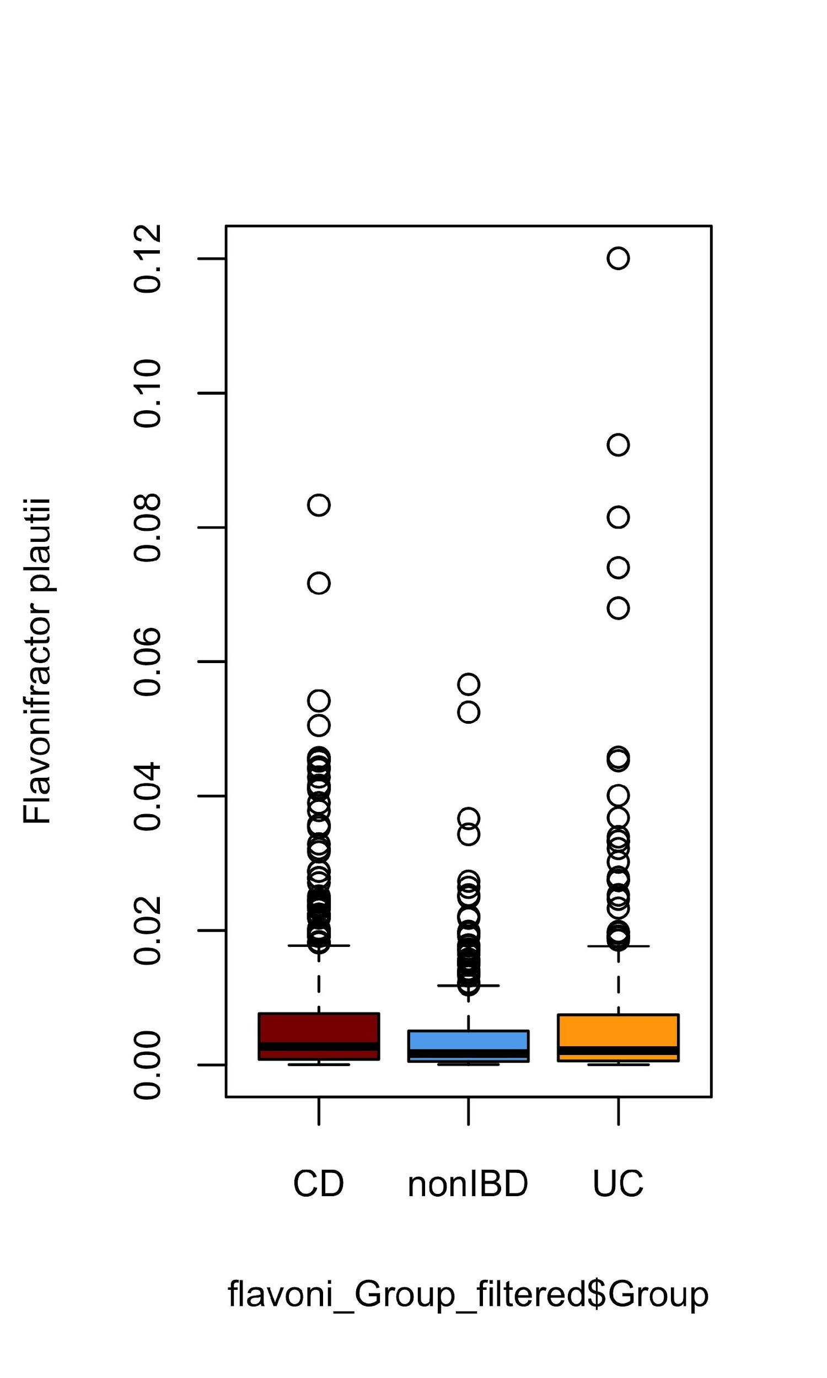
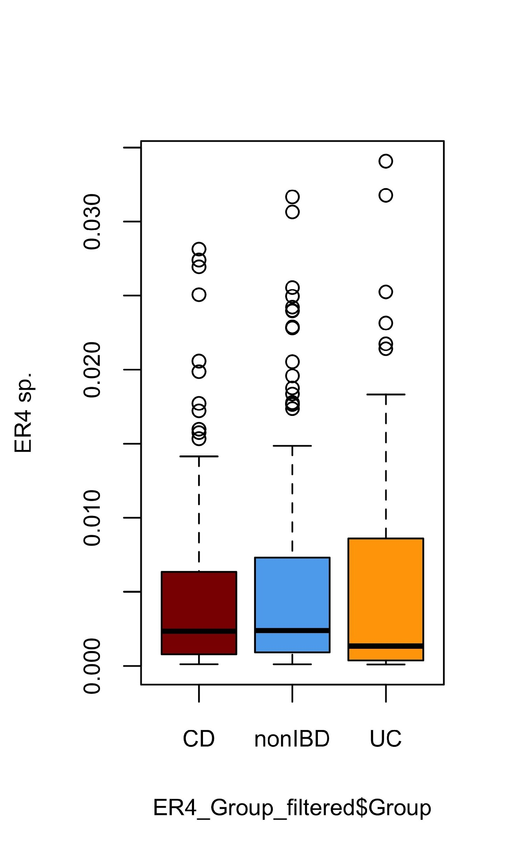
Microbial analysis
Bacterial replication rates
PTRs
p=**, effsize=0.11
p=**, effsize=0.11
p=**, effsize=0.04
p=**, effsize=0.03
p=**, effsize=0.10
Relative abundances
p=ns, effsize=0.002
p=ns, effsize=0.004
p=**, effsize=0.07
p=**, effsize=0.03
p=ns, effsize=-0.003

Slide 20
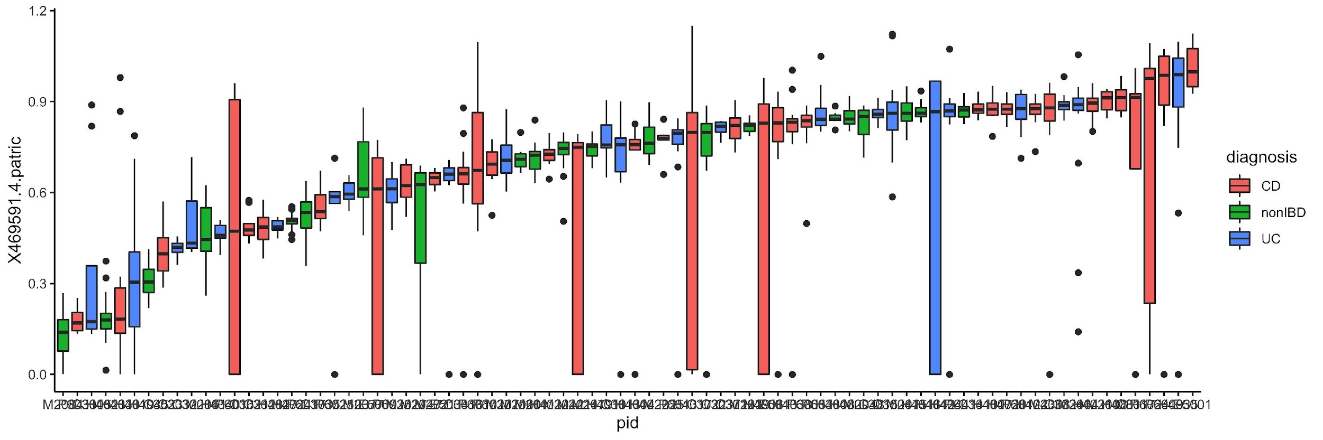
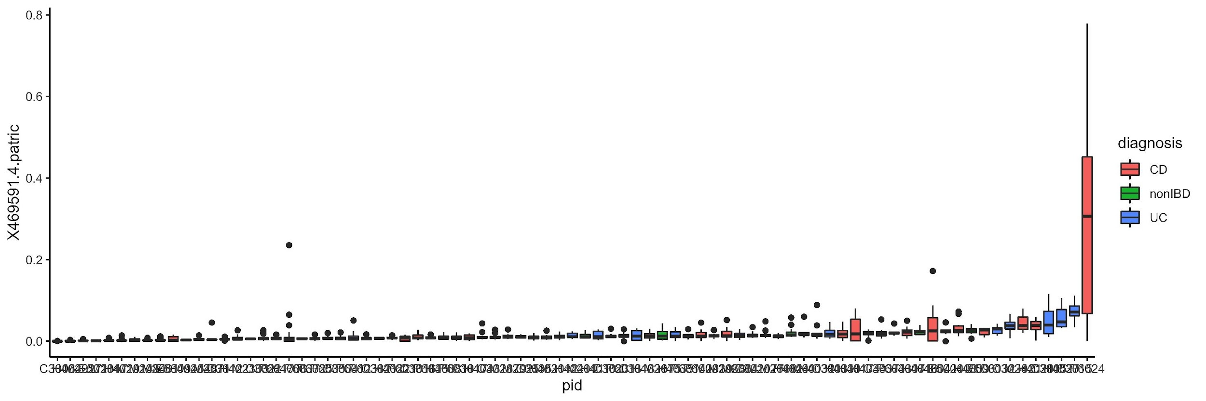
Microbial analysis
Bacterial replication rates
Parabacteroides distasonis
PTRs
Relative abundances

Slide 21
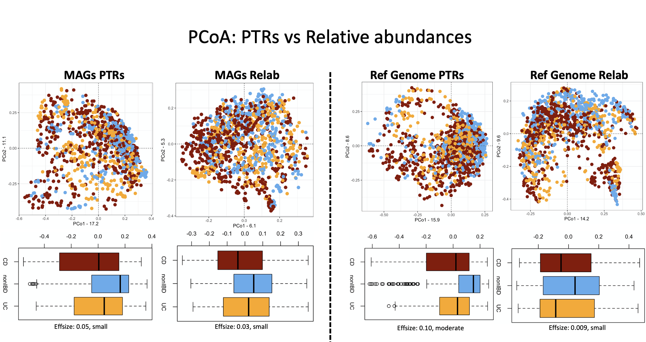
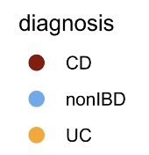
Microbial analysis
Bacterial replication rates

Slide 22
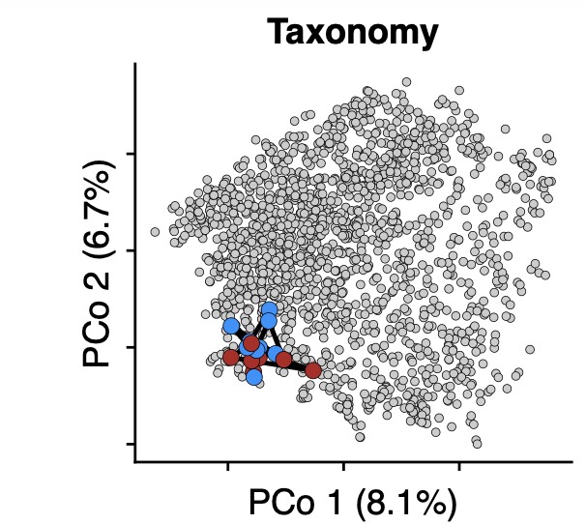
Microbial analysis
Bacterial replication rates
MetaPhln relative abundances
A ‘reference set’ of samples was constructed from non-IBD subjects by taking all samples
The dysbiosis score of a given sample was then defined as the median Bray–Curtis dissimilarity to this reference sample set
Divergent samples were identified – using a dysbiotic threshold at the 90th percentile of this score for non-IBD samples
Jason Lloyd-Price et. Al. 2019, Nature

Slide 23
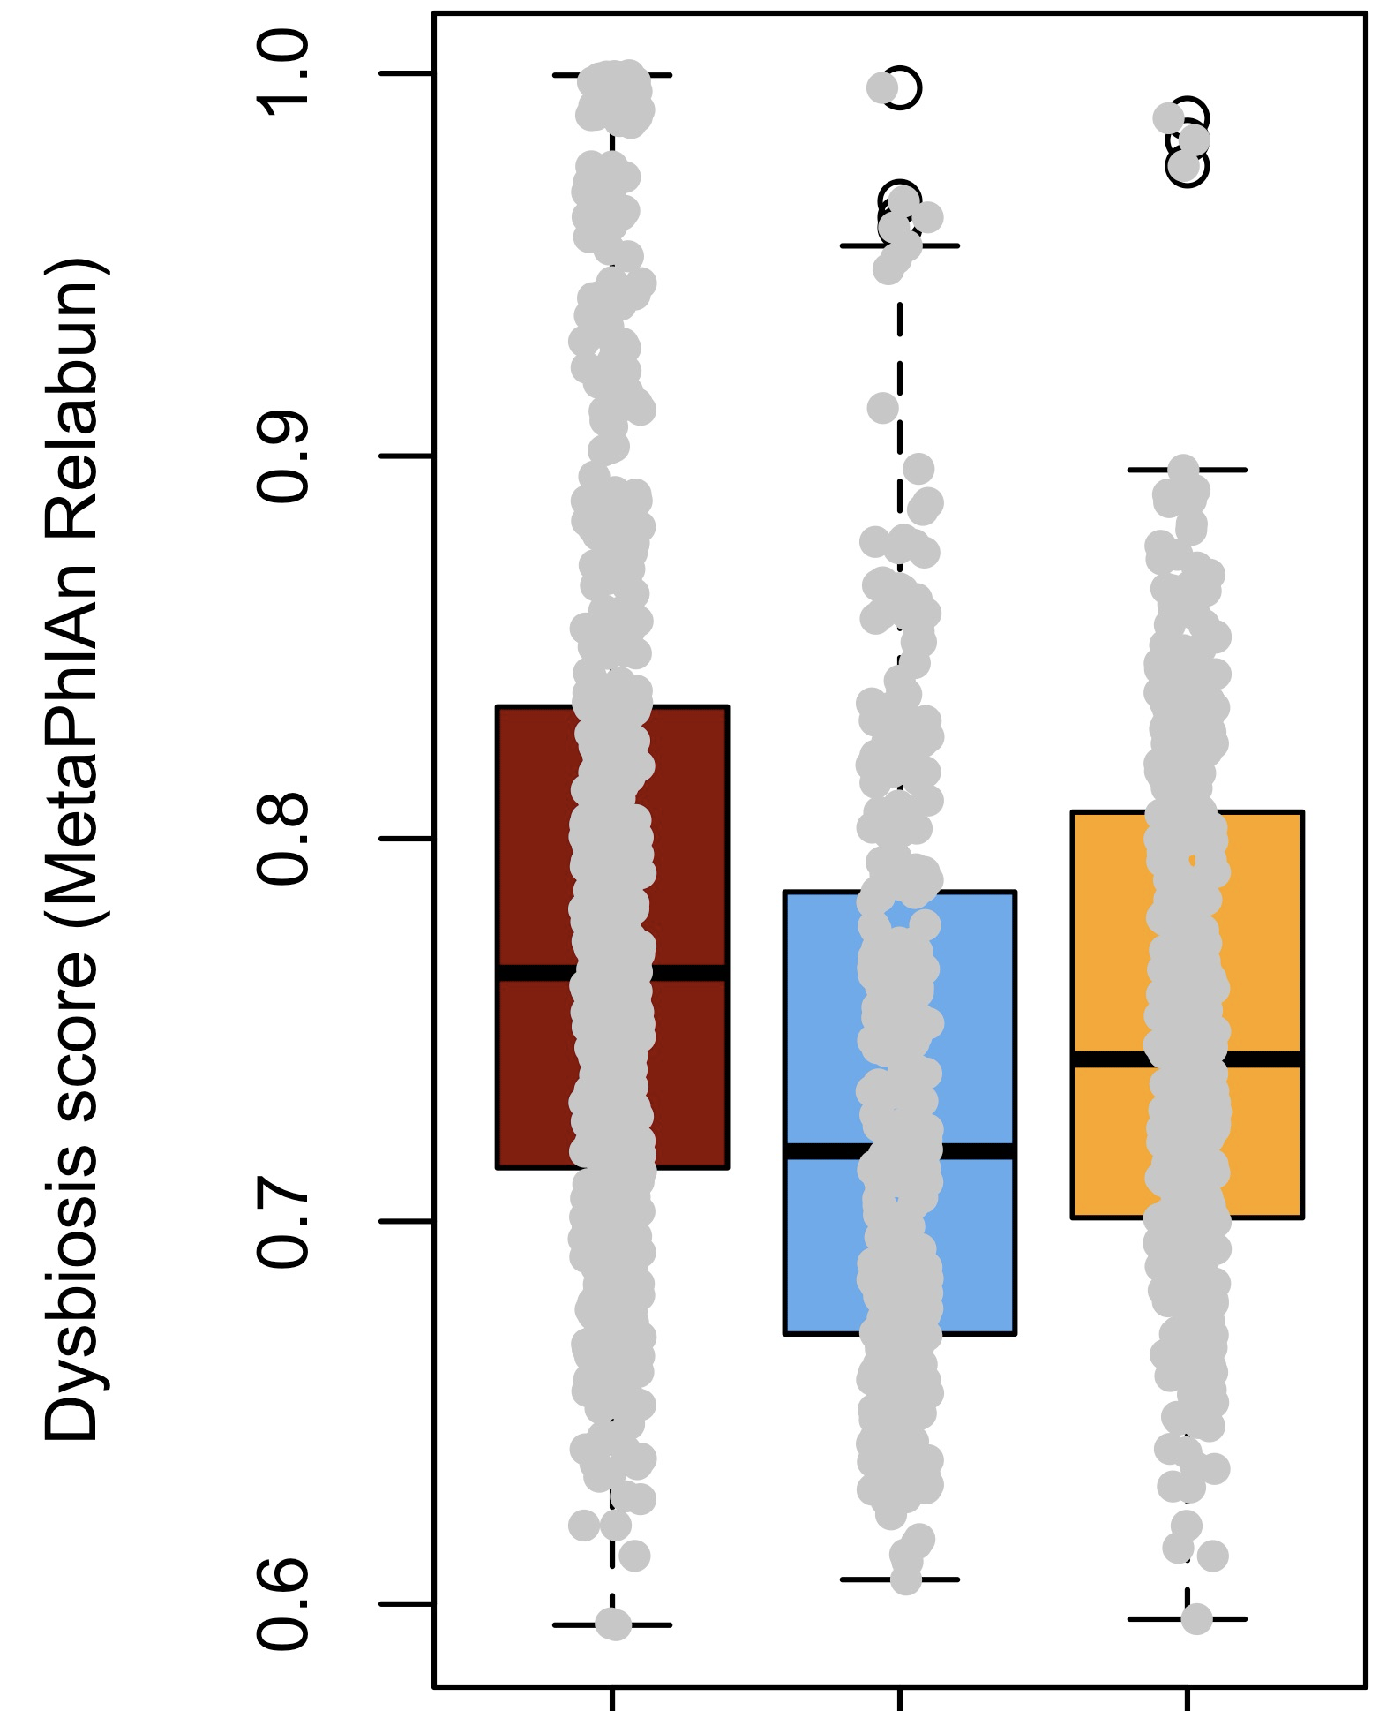
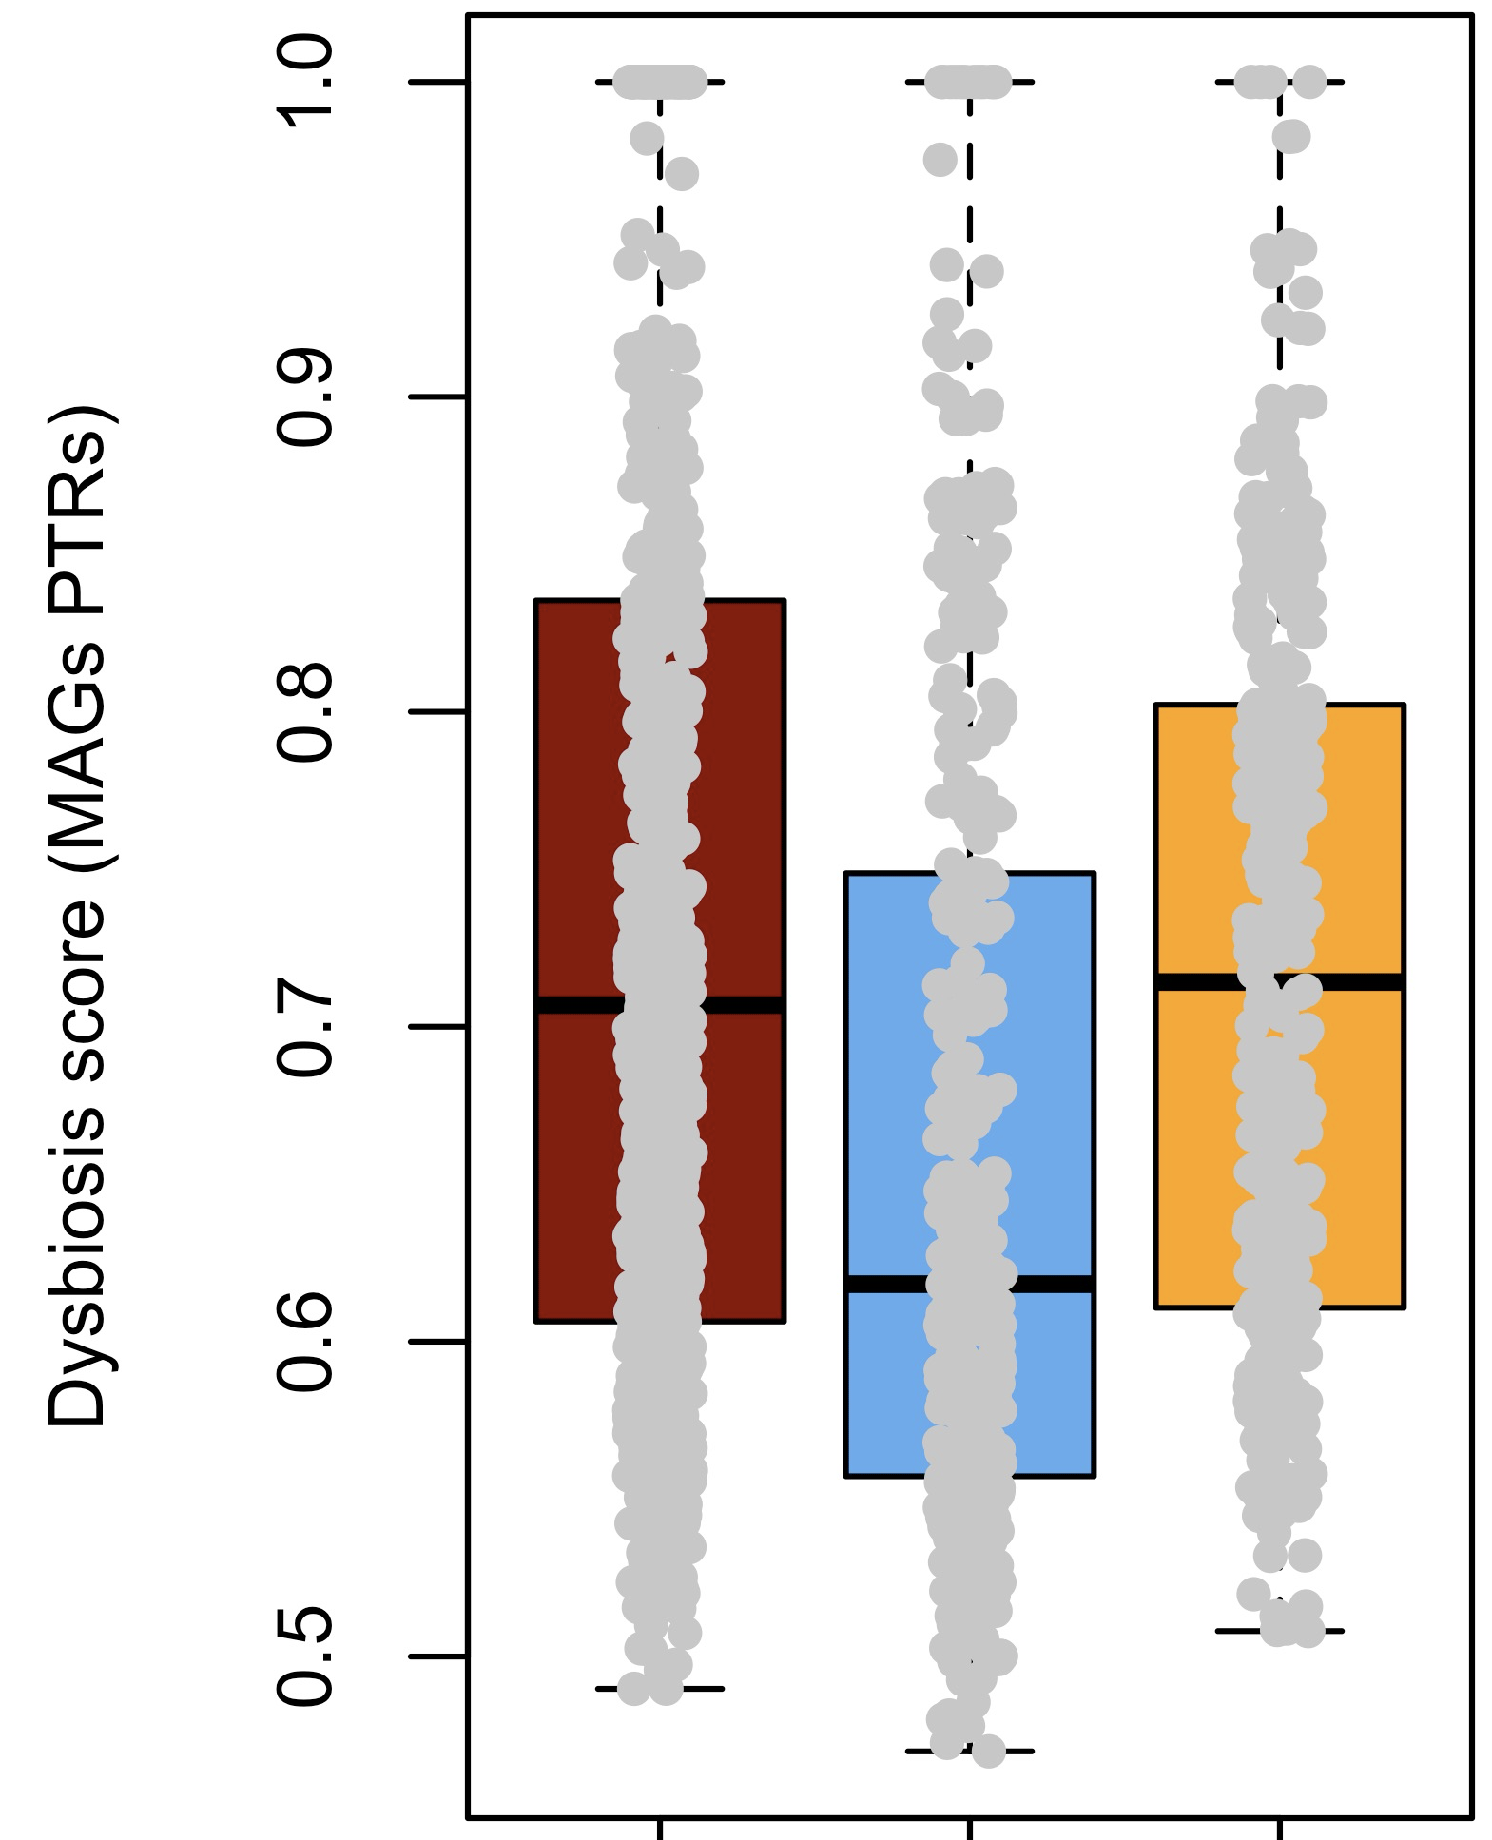
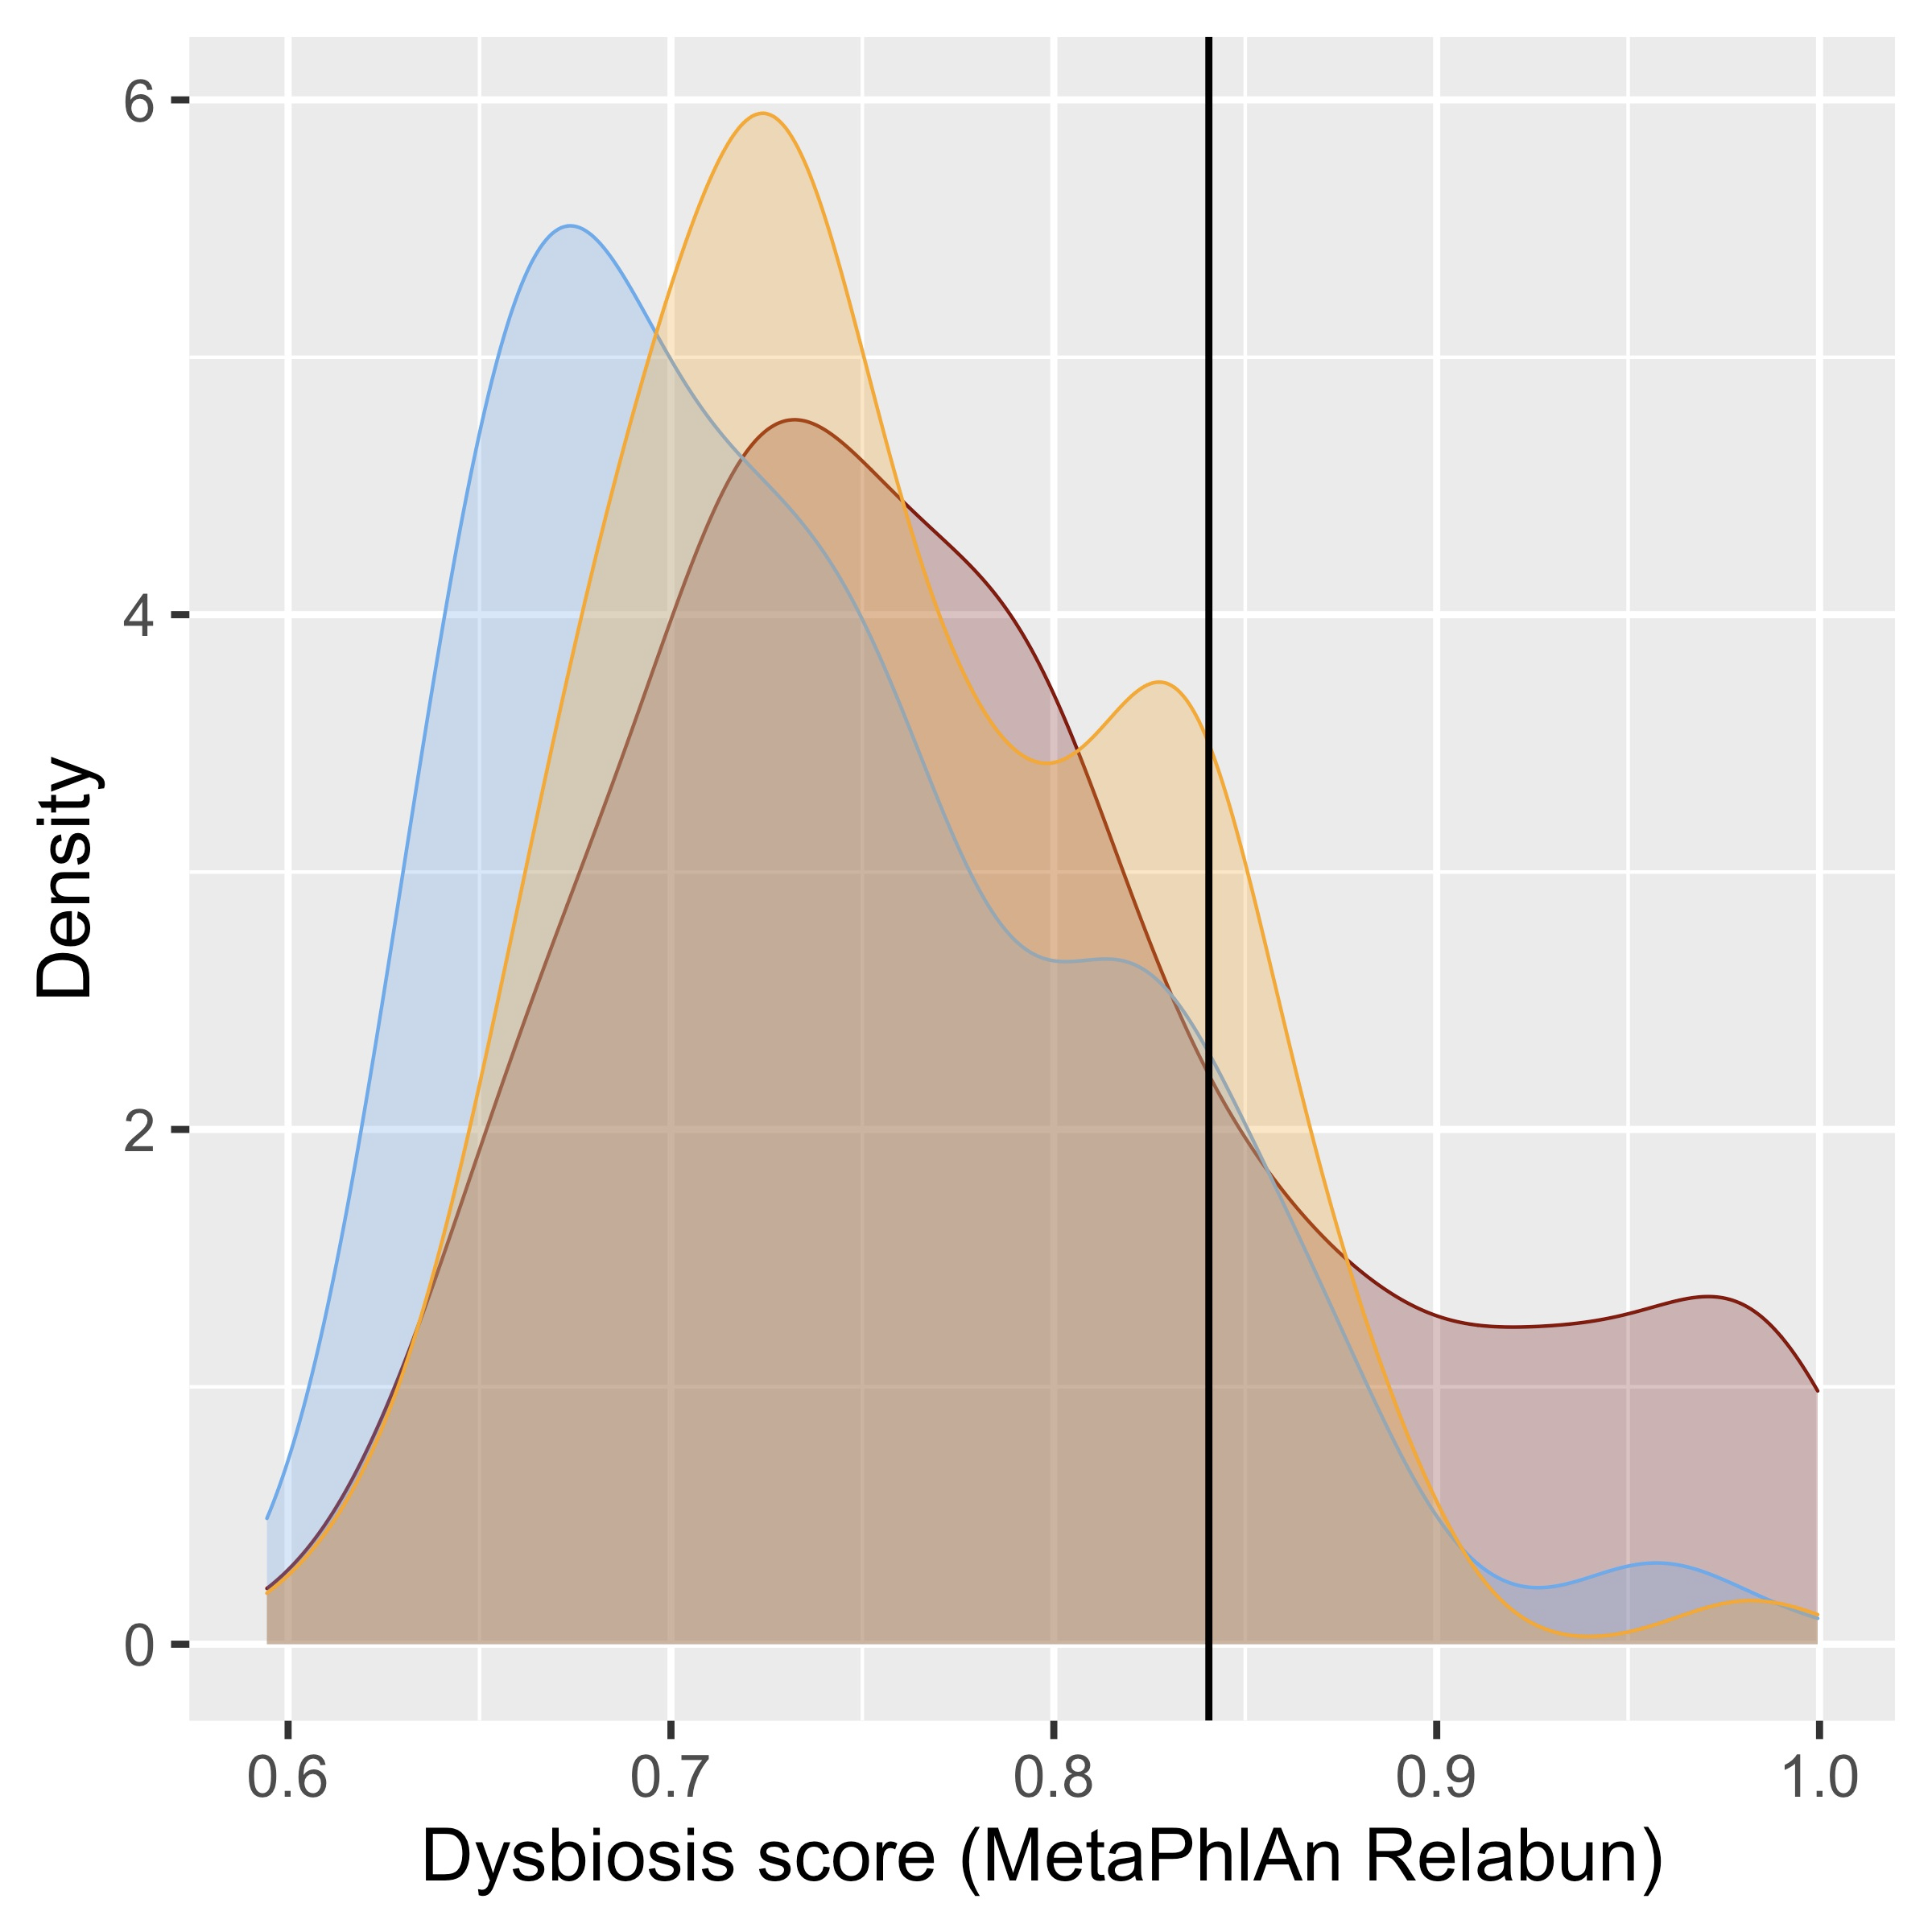
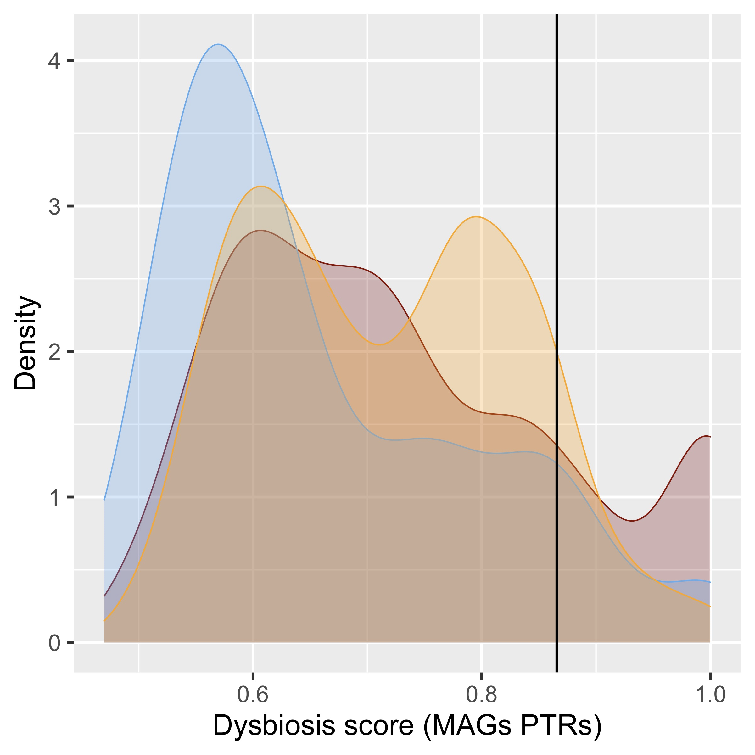
Microbial analysis
Bacterial replication rates

Slide 24
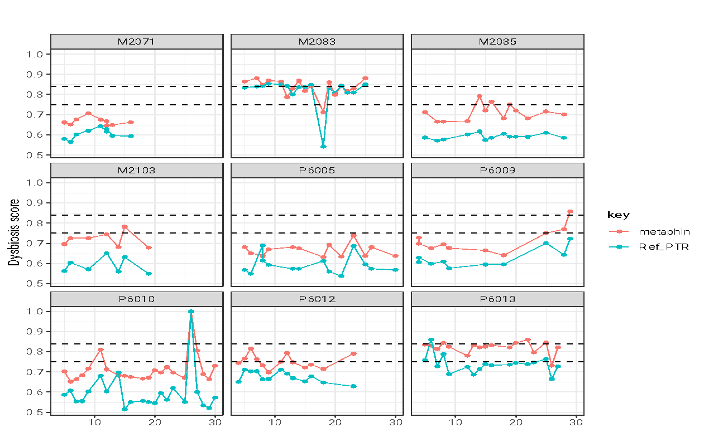
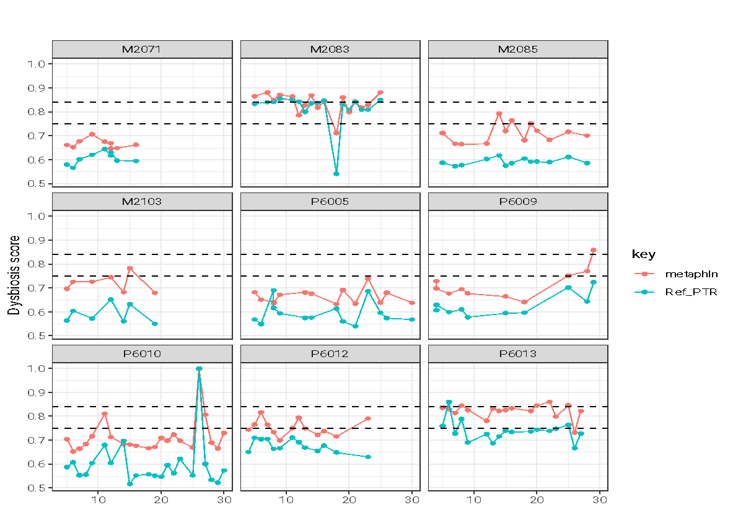
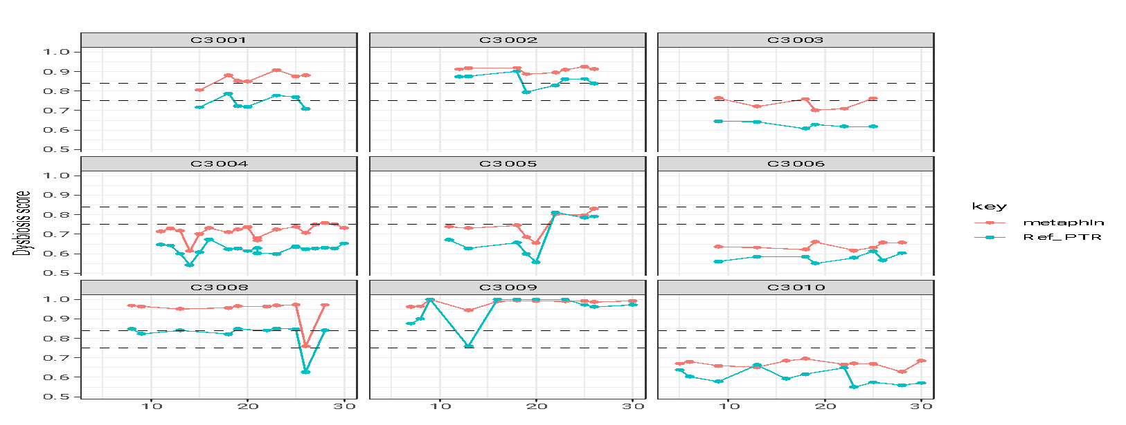
Microbial analysis
Bacterial replication rates
Relative abundances
PTRs or Replication rates
Threshold computed from Relative abundances
Dysbiosis score
Threshold computed using Replication rates

Slide 25
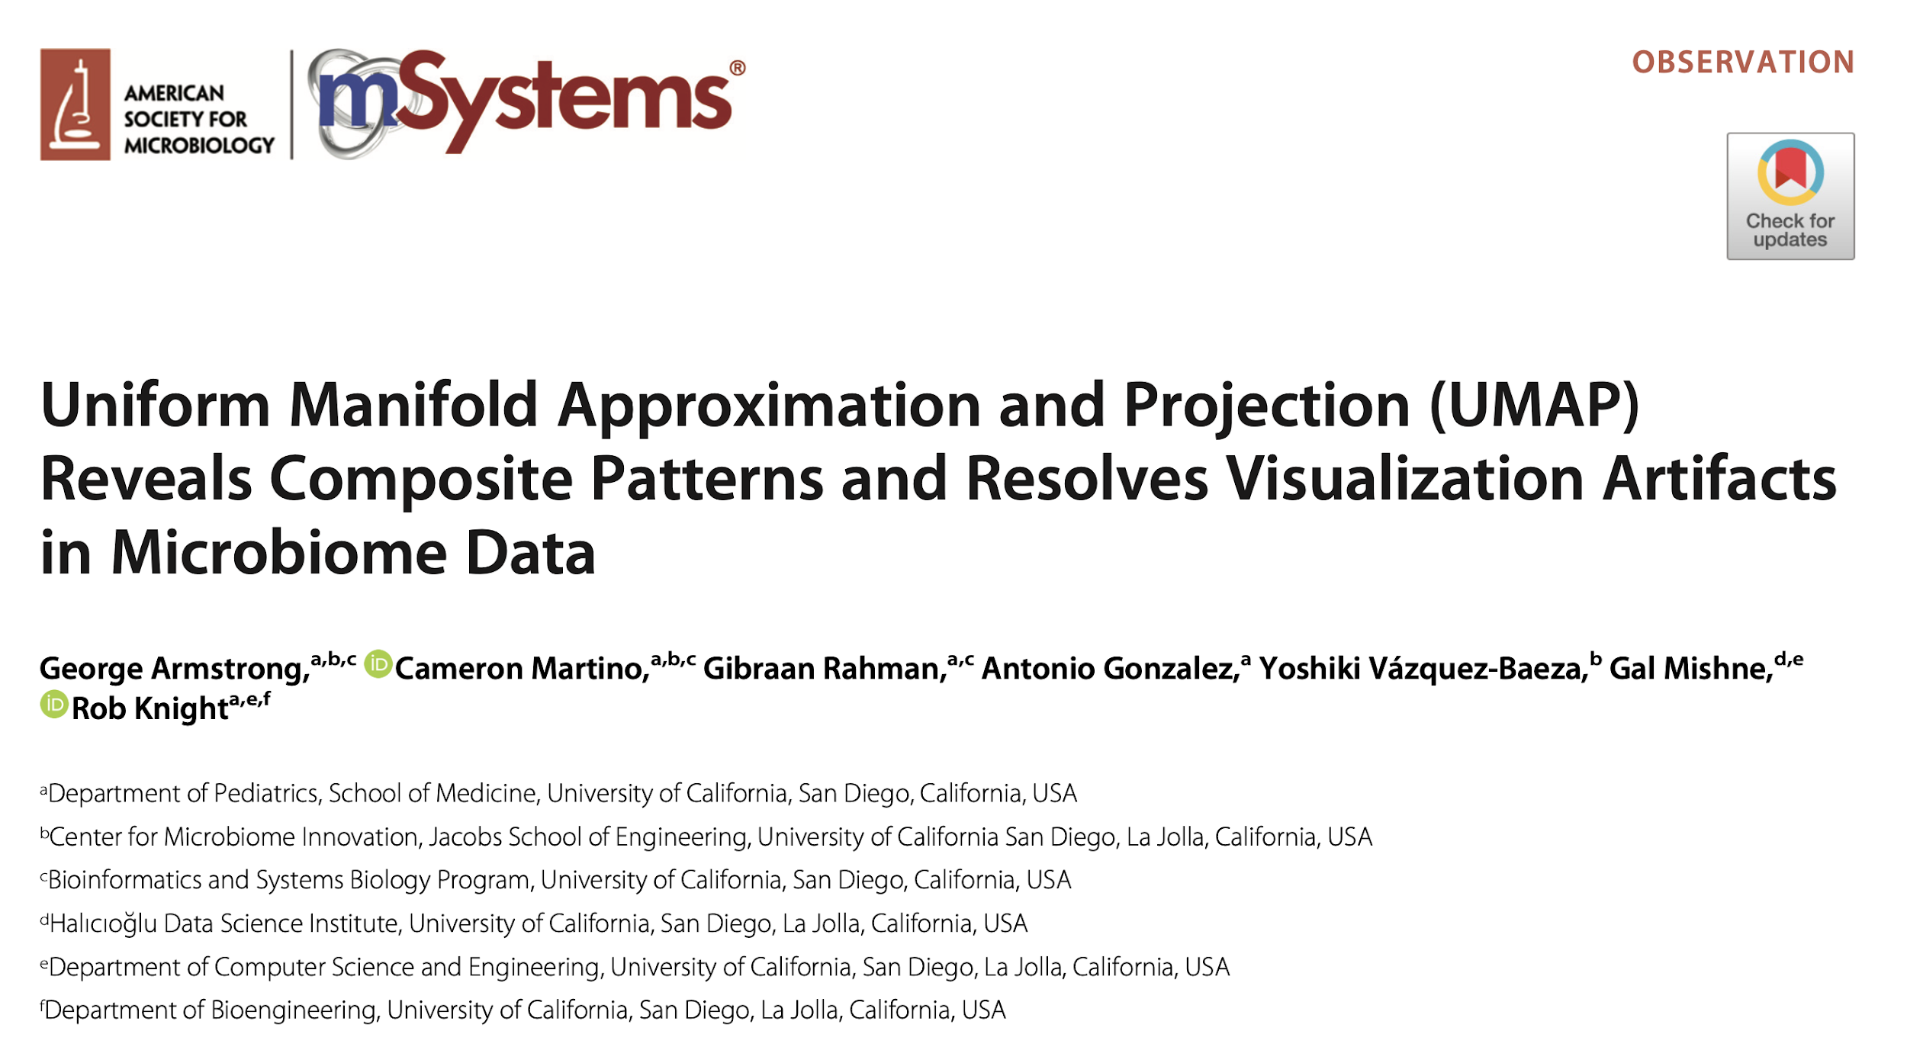
Microbial analysis
Bacterial replication rates

Slide 26

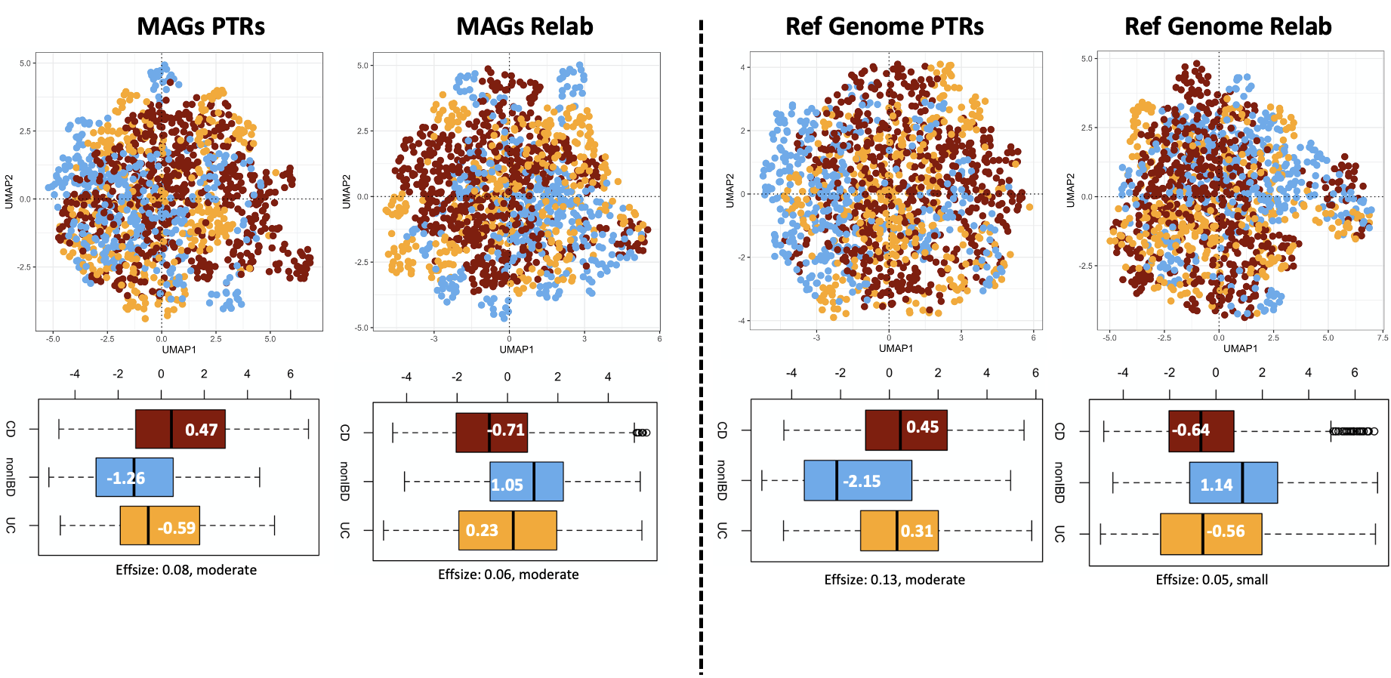
Microbial analysis
Bacterial replication rates

Slide 27
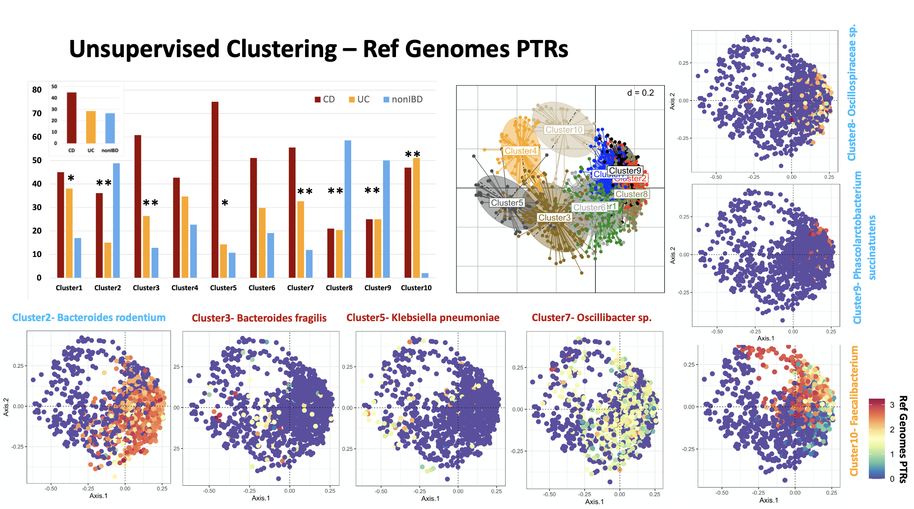
Microbial analysis
Bacterial replication rates

Slide 28
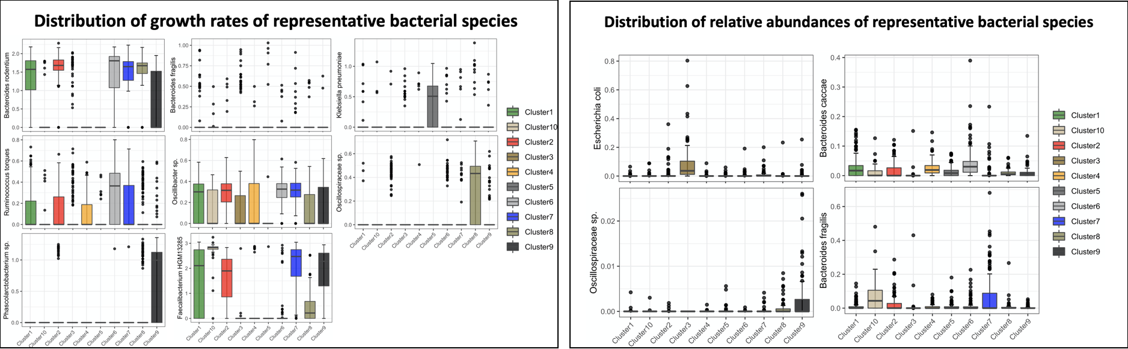
Microbial analysis
Bacterial replication rates
Association of cluster specific taxonomic markers with disease phenotype – Ongoing

Slide 29
Microbial analysis
Bacterial replication rates
Summary
Replication rates show stronger and more specific association with disease states
Unsupervised clustering on replication rates improve the segregation of disease states
Ongoing
Longitudinal analyses of replication rates (association with phenotypes/treatments)
More data (RISK (~300 samples), SPARC-IBD (>1000 samples), 1000IBD (~400 samples), and otherpopulation data)

Slide 30
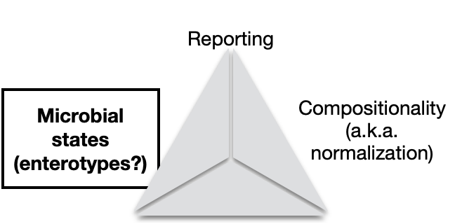
Microbial analysis
Microbial states – trajectory analysis

Slide 31


Microbial analysis
Microbial states – trajectory analysis

Slide 32
Microbial analysis
Microbial states – trajectory analysis

Slide 33



Microbial analysis
Microbial states – trajectory analysis

Slide 34

Microbial analysis
Microbial states – trajectory analysis

Slide 35
Microbial analysis
Microbial states – trajectory analysis
Summary
It is possible to identify informative bacterial features under the constrains of low prevalence
Identified features allow the definition of continuous enterotypes
Ongoing
Longitudinal analyses of replication rates (association with phenotypes/treatments)
More data (RISK, SPARC-IBD, 1000IBD, population data)

Slide 36

Acknowledgements
Dr. David Casero
Dr. Suzanne Devkota
Dr. Jonathan Braun
Dr. Ivan Vujkovic-Cvijin
Inflammatory Bowel & Immunobiology Research Institute Team (IBIRI)

